Slide 1
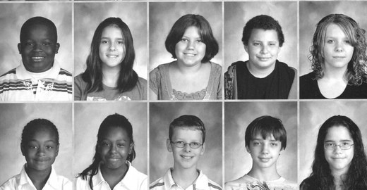
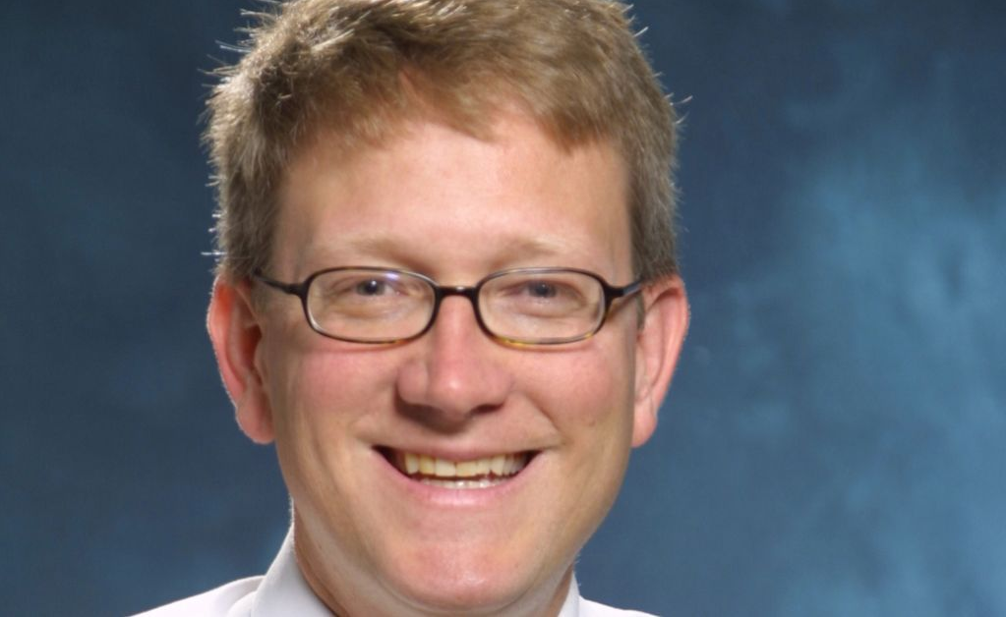
Dr. Blake Fagan
Stopping the Epidemic of Prescription Painkiller and Opioid Addiction and Death
Chief Education Officer, Mountain Area Health Education Center
Assistant Residency Director MAHEC Family Medicine Residency Program
Assistant Medical Director, MAHEC Division of Family Medicine
Associate Professor, UNC-Chapel Hill SOM

Slide 2
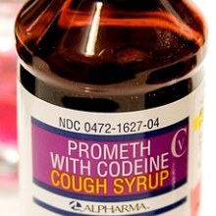
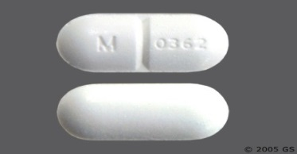
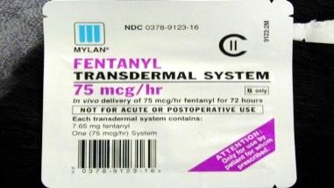
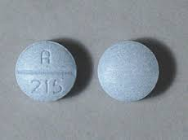
What are opioids (prescription painkillers)?
Codeine
Oxycodone
Vicodin
Fentanyl
Notes:
Opioids are chemicals that are either produced from the opium poppy plant or created in a lab to have the same effects. Some opioids are prescription medicines, such as oxycontin or vicodin.
Some are medicines that are produced illicitly. Some are illegal drugs.
Opioid drugs work by binding to opioid receptors in the brain, spinal cord, and other areas of the body. They reduce the sending of pain messages to the brain and reduce feelings of pain.

Slide 3
The United States has 4.6% of the world’s population, yet we use 80% of the world’s opioids
Notes:
95% of all the Vicodin in the entire world is consumed by the US

Slide 4
OVER 17 MILLION PAINKILLERS PRESCRIBED IN BUNCOMBE COUNTY IN 2016
This equals almost 68 pills for every Buncombe County resident
Notes:
This equals almost 68 pills per every Buncombe County resident
Swimming in a toxic sea of pills and it has consequences….heroin use, Ods, suicide, babies born, families separated.
https://www.ncdhhs.gov/divisions/mhddsas/ncdcu/prescription-rates-by-county

Slide 5
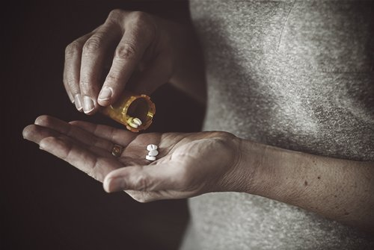
What we know now … It only takes a little to become addicted
Notes:
Opioids are useful in end of life situations- not necessarily cancer
Severe trauma for a short period of time

Slide 6
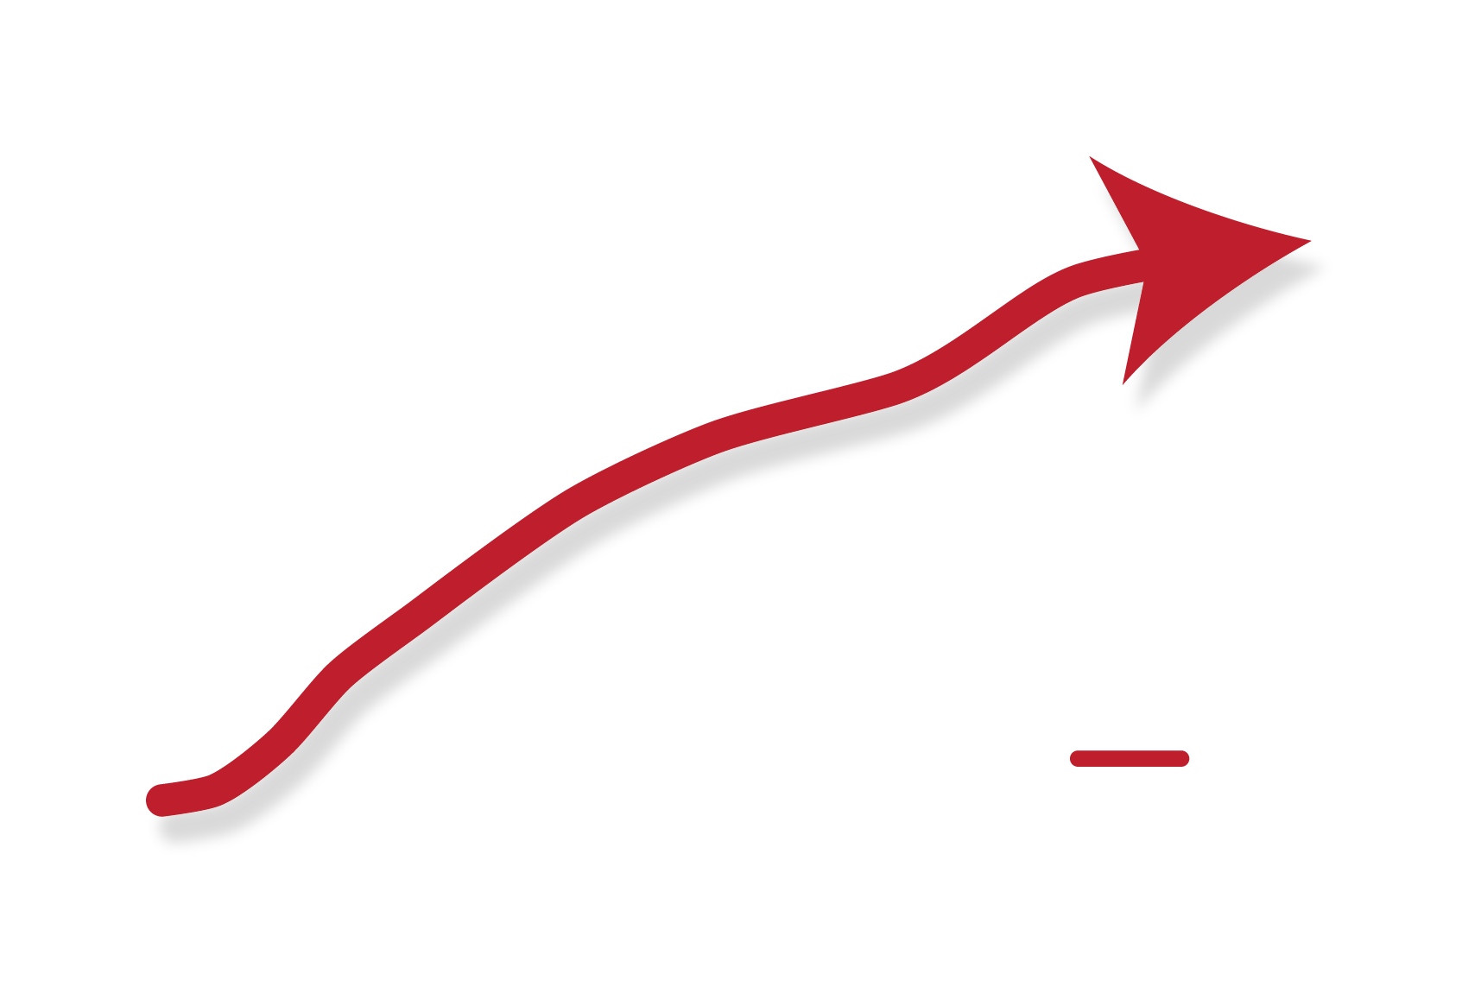
Your risk of addiction rises quickly with each day you take painkillers
Notes:
Opioid medications can produce a sense of well-being and pleasure because these drugs affect brain regions involved in reward. People who abuse opioids may seek to intensify their experience by taking the drug in ways other than those prescribed.
For some, it can take as little as a week to become dependent on painkillers. Once addicted, the patient continually seeks to prevent the withdrawal symptoms, others seek the euphoria they felt in the beginning – before they developed a tolerance – but they are never able to achieve it again. Some overdose and die trying. Others are self medicating by constantly taking the opioid only to prevent the withdrawal symptoms.
One- and 3-year probabilities of continued opioid use among opioid-naïve patients, by number of days’ supply* of the first opioid prescription — United States, 2006–2015
https://www.cdc.gov/mmwr/volumes/66/wr/mm6610a1.htm

Slide 7
…
Has anyone here been complicit?
Notes:
Confession

Slide 8
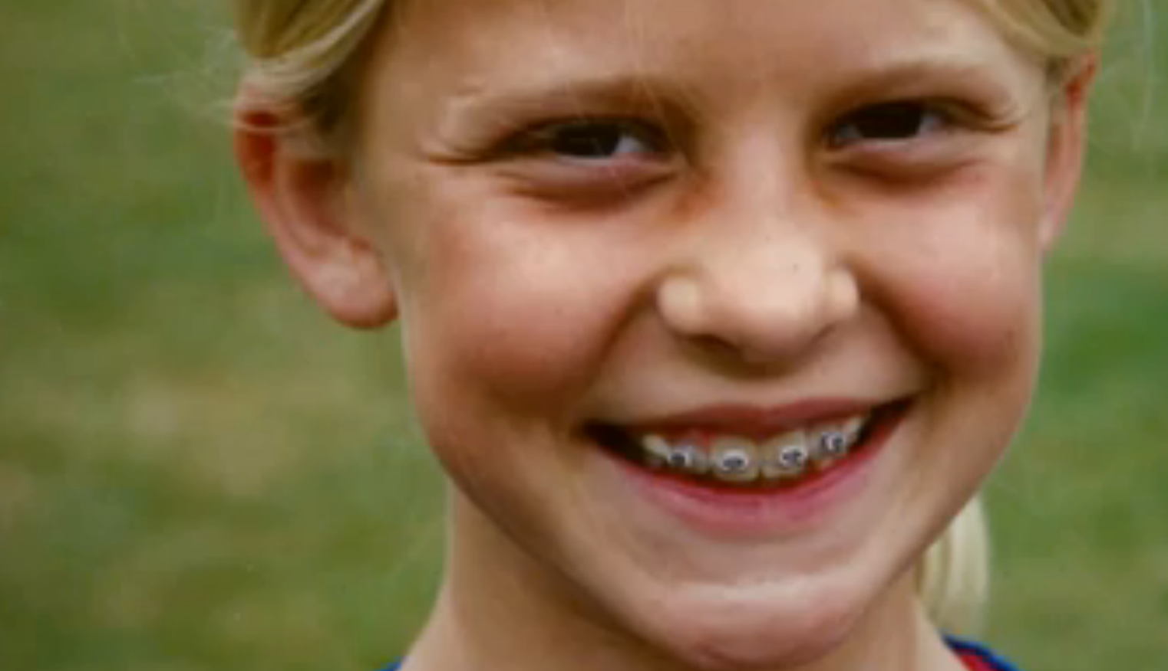
We all have a role to play in this public health crisis

Slide 9

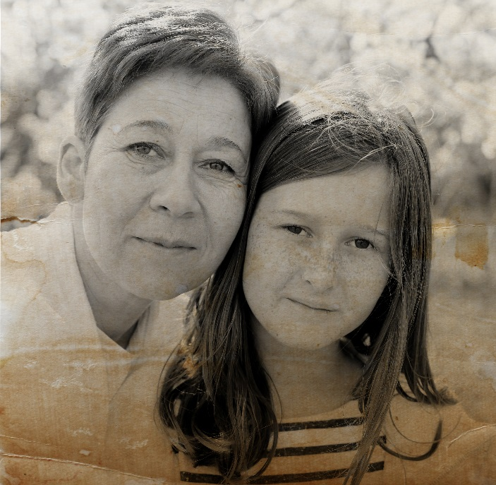
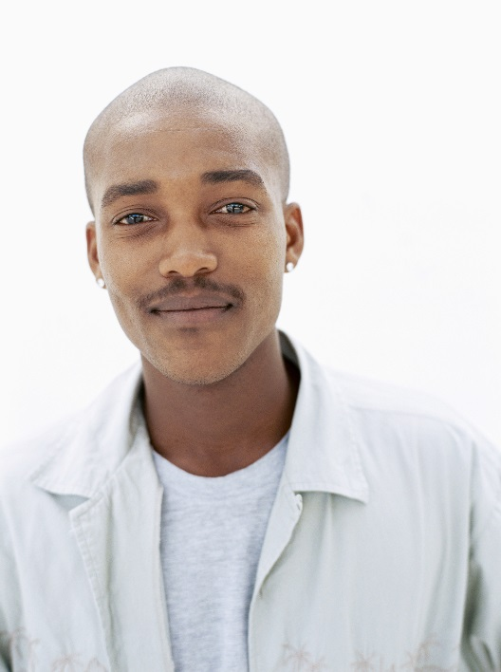
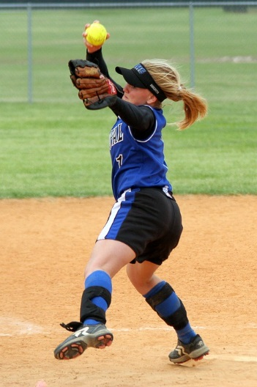
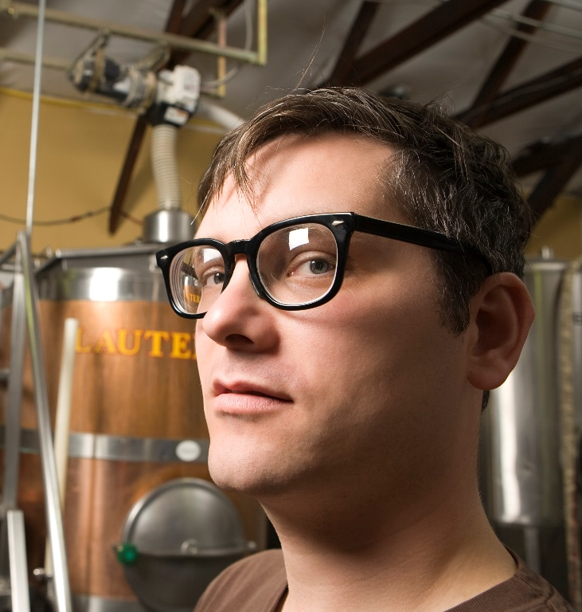
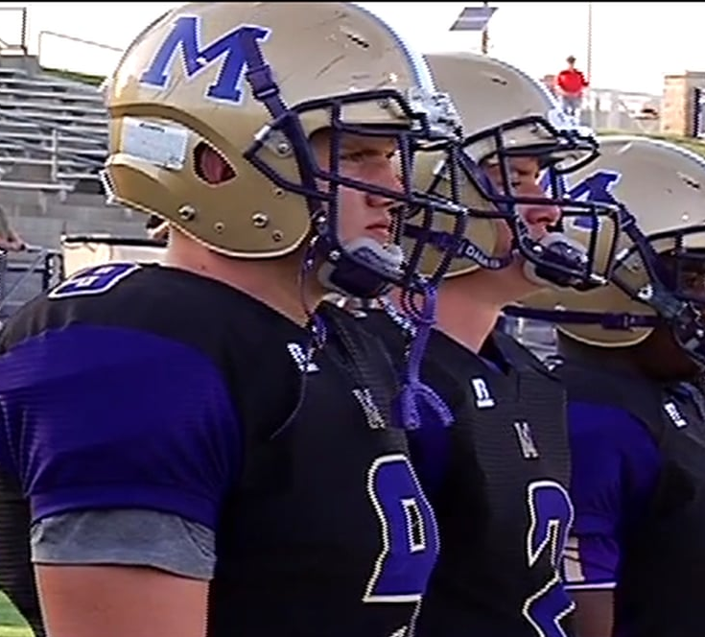
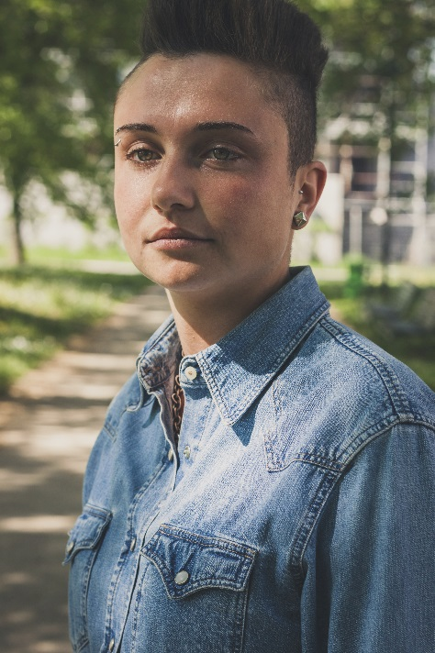
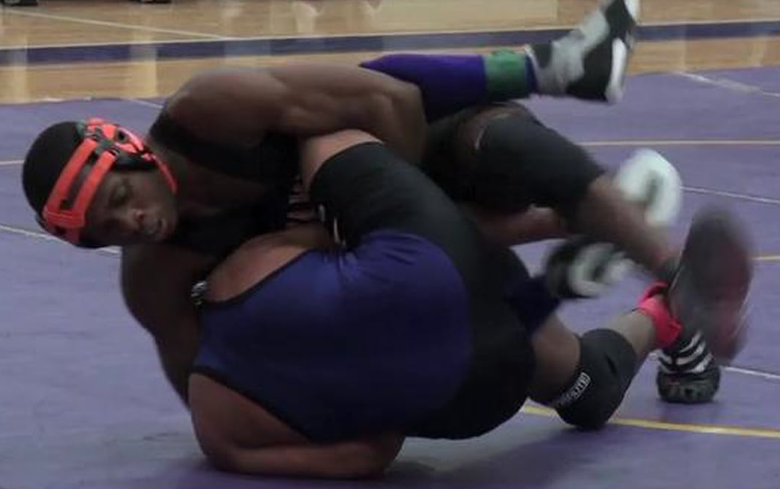
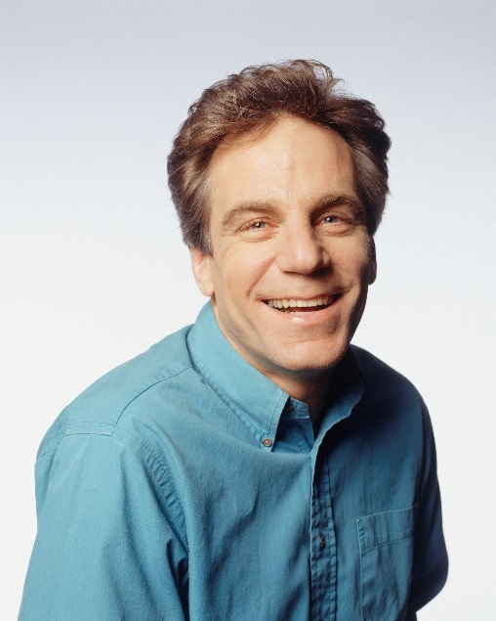

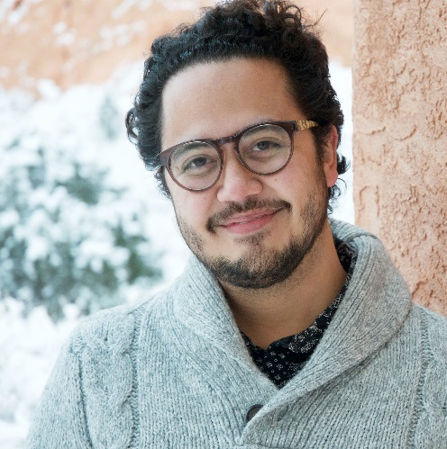
Notes:
Anyone can be battling addiction. I would bet that addiction has touched everyone in this room.
Why do people start abusing opioids?
A person may:
Begin to misuse meds by increasing the dose on their own
Use to cope with emotional stress or pain or trauma
Experiment with opioids as a way to get high- take other people’s medication

Slide 10
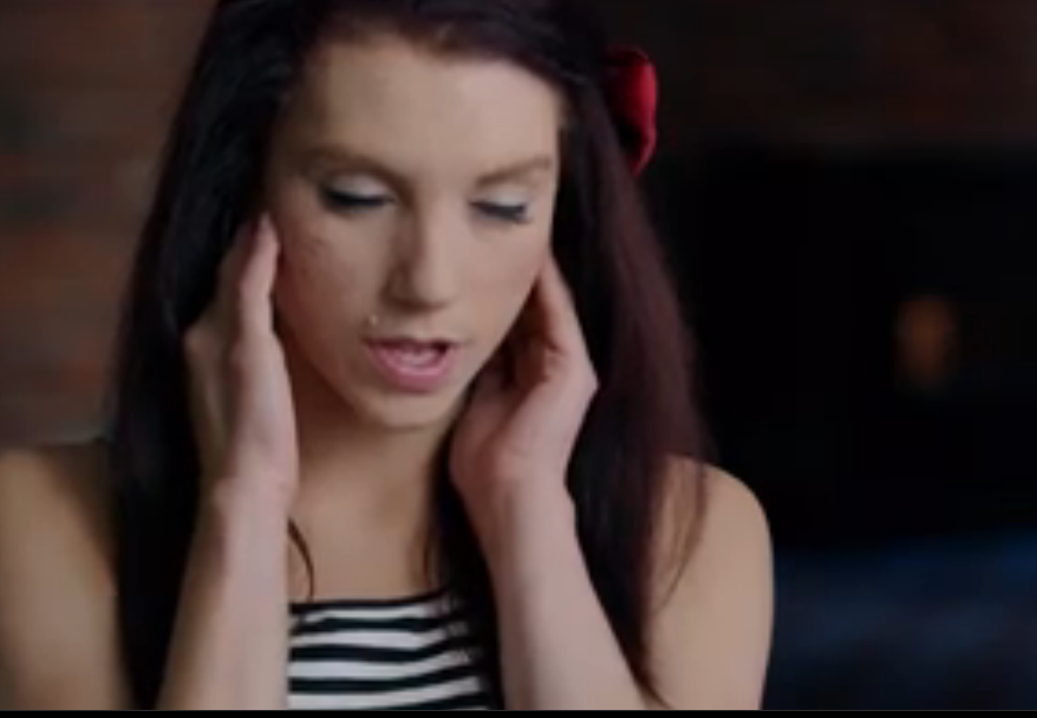
“Heroin literally has a brain and it shares mine.”
-Kristina Block
Notes:
Fear of withdrawal is one reason that they continue to use. Withdrawal undoes everything that opioid intoxication does – and when the pendulum swings back it can be very painful.
If a user gets through physical withdrawal they may then experience emotional withdrawal: missing the feeling of being high. This can result in relapse, which means that a user starts using again.
Relapse is dangerous because a user may go back to using the same dosage they did prior to stop using, but their body is not ready for it. What do you think happens at this point?

Slide 11
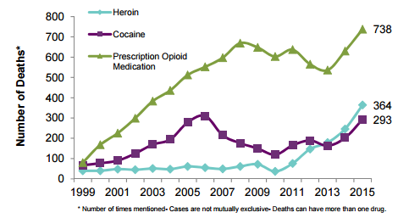
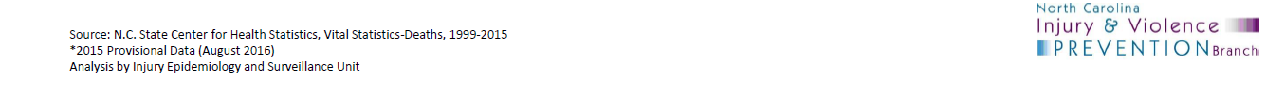
Notes:
As you can see, when prescription painkiller death rates start to drop, heroin deaths rise.
If current trends continue, unintentional poisoning deaths will surpass motor vehicle deaths as the leading cause of injury death in North Carolina by 2017.
This data is the tip of the iceberg… we know that addiction is everywhere in our community, across homes and neighborhoods
http://www.injuryfreenc.ncdhhs.gov/About/PrescriptionFactSheet2015-Oct2016.pdf

Slide 12
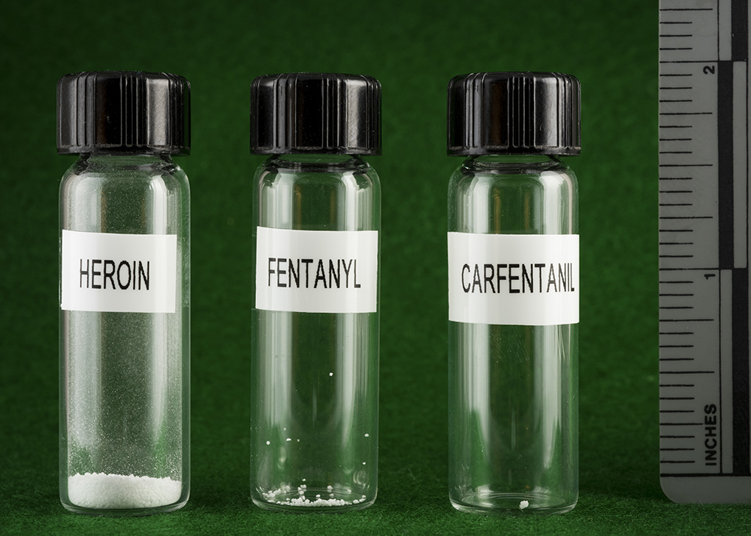
It doesn’t take a lot to kill
NEW HAMPSHIRE STATE POLICE FORENSIC LAB
Notes:
Fentanyl is a stealth killer, often sold to clueless buyers as heroin, prescription pain pills or the anti-anxiety medication Xanax. It’s deadly because it’s so much stronger than heroin, as shown by the photograph above, which was taken at the New Hampshire State Police Forensic Laboratory. On the left is a lethal dose of heroin, equivalent to about 30 milligrams; on the right is a 3-milligram dose of fentanyl, enough to kill an average-sized adult male.
Drugs users generally don’t know when their heroin is laced with fentanyl, so when they inject their usual quantity of heroin, they can inadvertently take a deadly dose of the substance.
The drug has flooded the marketplace as street dealers on up to major international cartels have discovered that it delivers heroin’s high at a fraction of the cost. This creates a paradox where the profit margin for drug sellers skyrockets as the street price for opioids drops.
The result: Fentanyl is poised to become the catastrophic exclamation point to 20 years of escalating opioid addiction in the United States.

Slide 13
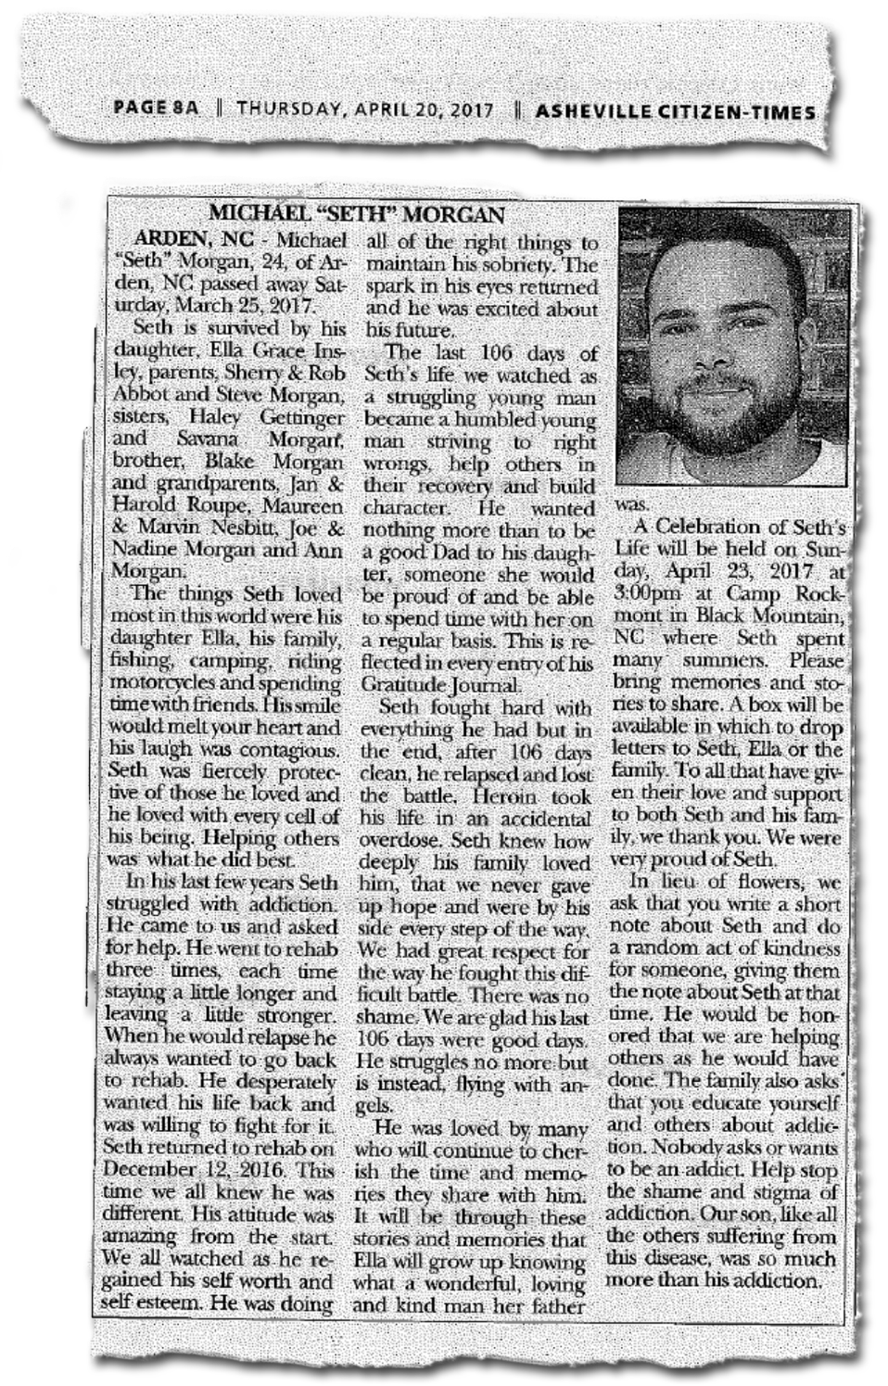
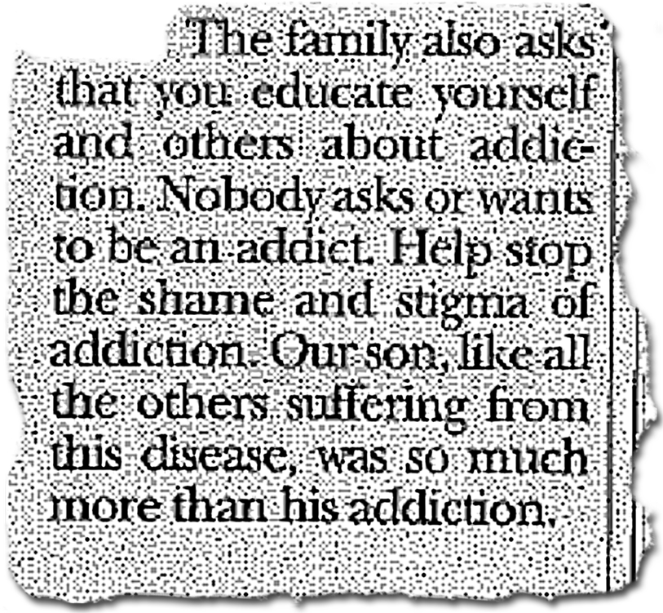
The disease of addiction thrives in darkness and must be defeated in the light
Notes:
And we treat addiction differently, don’t we? Than other chronic diseases.
Once you are diagnosed with a disease, you have a disease. It may go into remission or become more manageable but it’s still there. If you have been diagnosed with diabetes, we don’t stop treating you with insulin if you don’t follow your diet and exercise routine, right? We don’t NOT give you insulin because your body isn’t making enough.
It’s important to separate the person from the addiction if we are to give them any hope for a different future.
Science has proven that substance use disorder is a chronic brain disease that can be managed with medical treatment. It is NOT a moral failing or a character flaw.
But still, only 1 in 10 Americans with a substance use disorder receive treatment.¹
Addiction is highly stigmatized, and that stigma is fueling an American public health crisis. With both cancer and HIV: when stigma was reduced, lives were saved. And the same can be true of addiction.

Slide 14
The epidemic is everywhere in our community
Notes:
It is in our doctor’s offices, our schools, our workplace, in our homes, and in our families. And it is threatening to tear our community apart.

Slide 15
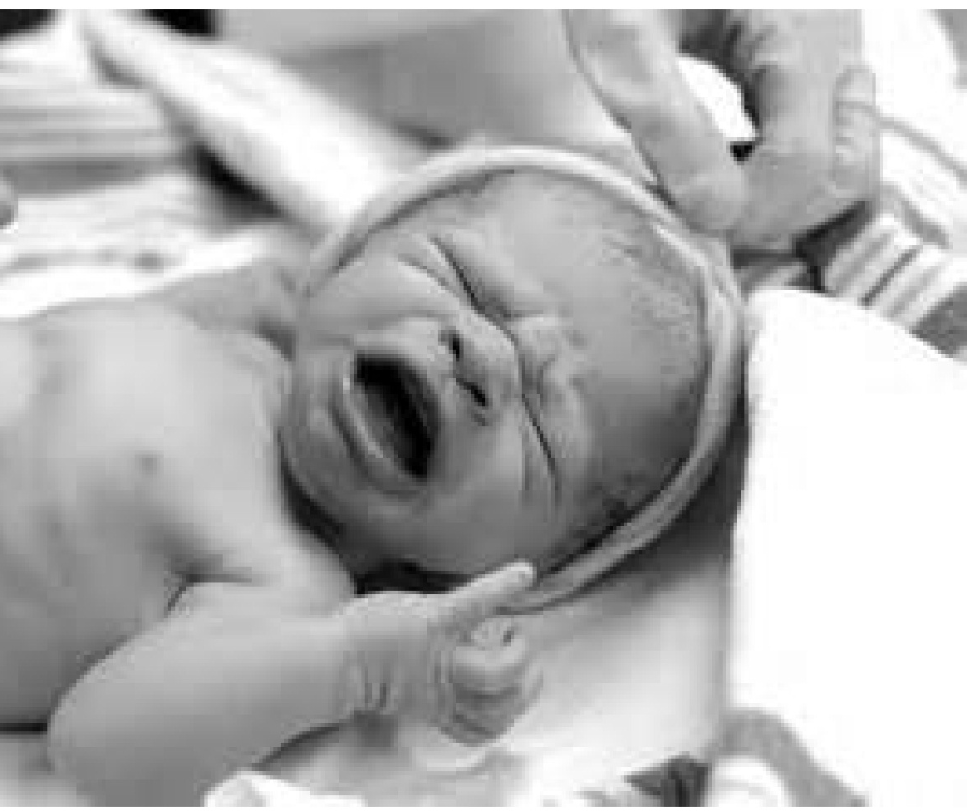
399
Babies born at Mission tested positive for substances.
The majority of children in foster care have a parent that struggles with a substance use addiction.
Notes:
(154 of these are Buncombe County babies)
NC: From 2004-2013, there has been a 604% increase in hospitalizations associated with drug withdrawals in NEWBORN BABIES.

Slide 16
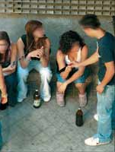
Buncombe County EMS responded to 1,270 overdose calls in last 5 months (Jan 2017 - May 2017)
194 OD calls in May- by the middle of the month
Notes:
Add narcan usage data

Slide 17
…
Does any of this information surprise you?

Slide 18
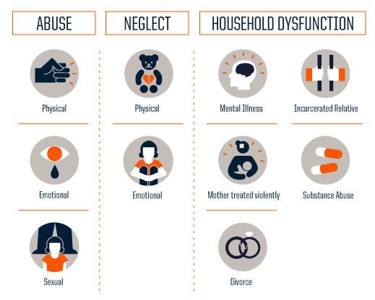
Did you know drug abuse can be related to trauma?
Notes:
At risk:
Symptoms of trauma - Stress, depression
Access to an addictive substance is another risk factor.

Slide 19
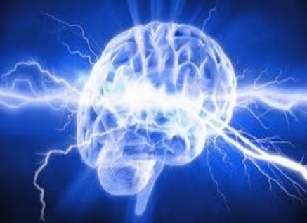
The ESSENCE of what drives teenage behavior
Emotional Stimulation/Spark
Social Engagement
Thrill seeking behavior
Opening windows to creativity through drugs
Notes:
More than 90% of adults with substance use disorders started using before age 18
half of these cases started using drugs before age 15
In short, being a teenager is a risk factor
**SAMSHA report

Slide 20
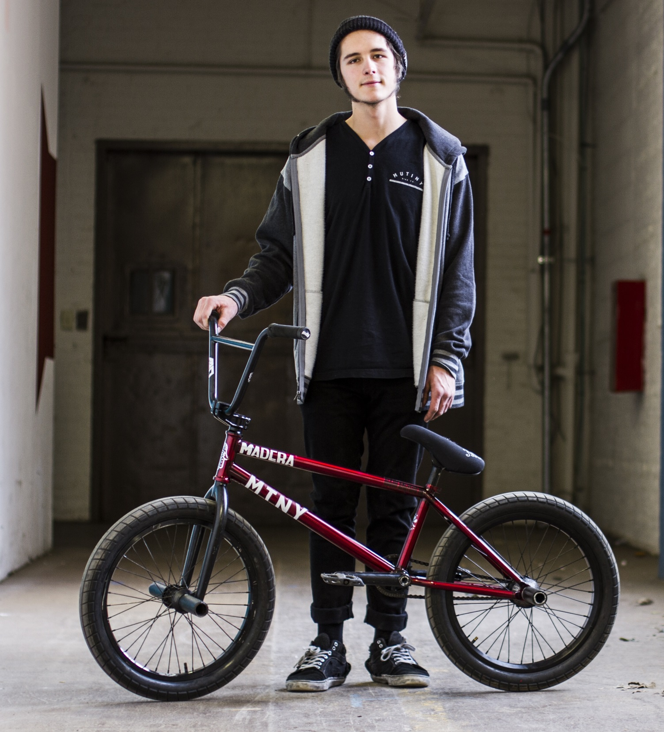
Encourage caregivers to talk to their children.
Children who learn about the dangers of drugs at home are up to 50 percent less likely to use drugs
Notes:
One of the biggest reasons kids give for not using is that they don’t want to disappoint their parents But Most teens say that their parents have not talked with them about prescription drug abuse

Slide 21
Educate others on what to look for:
Pinpoint pupils
Unkempt, dirty appearance
Track marks
Laughs at nothing
Cash flow issues / missing valuables
Missing / burnt spoons
Withdrawn or depressed
Makes endless excuses
Uncharacteristically loud, obnoxious behavior
Notes:
Other signs are A dirty, unkempt appearance and general neglect of hygiene, which are strong indicators of drug use They may appear depressed, and/or withdraw socially And you may see track marks – which commonly occur on hands and arms (which is why they may wear long sleeved shirts even when it’s inappropriate for the weather). However, someone who has used for a while will inject anywhere they can find a vein.
You may find missing or burnt spoons, which are used to smoke heroin, or foil or missing money or valuables – heroin and pills aren’t free.
The best advice is to trust your instincts. If something doesn’t seem right, it might not be.
https://www.youtube.com/watch?v=16YhXNlC414

Slide 22
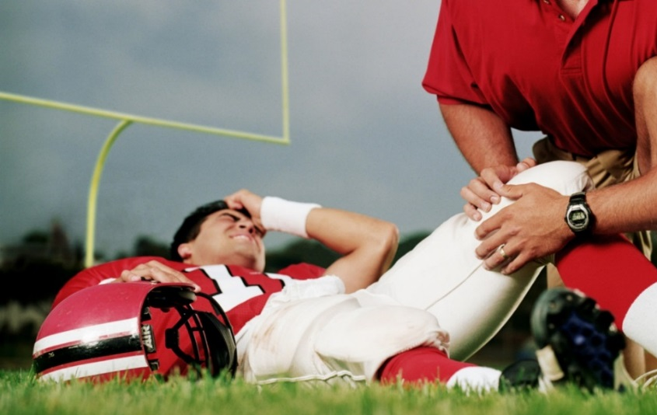

Prescription painkillers are a last resort.
Ask doctors and nurses:
What are the risks associated with painkillers?
Are there other ways to treat the pain other than painkillers?
What are the side effects of painkillers?
When can I switch to acetaminophen (Tylenol) and ibuprofen (Advil)?
Remind Parents: Never ever share your meds

Slide 23
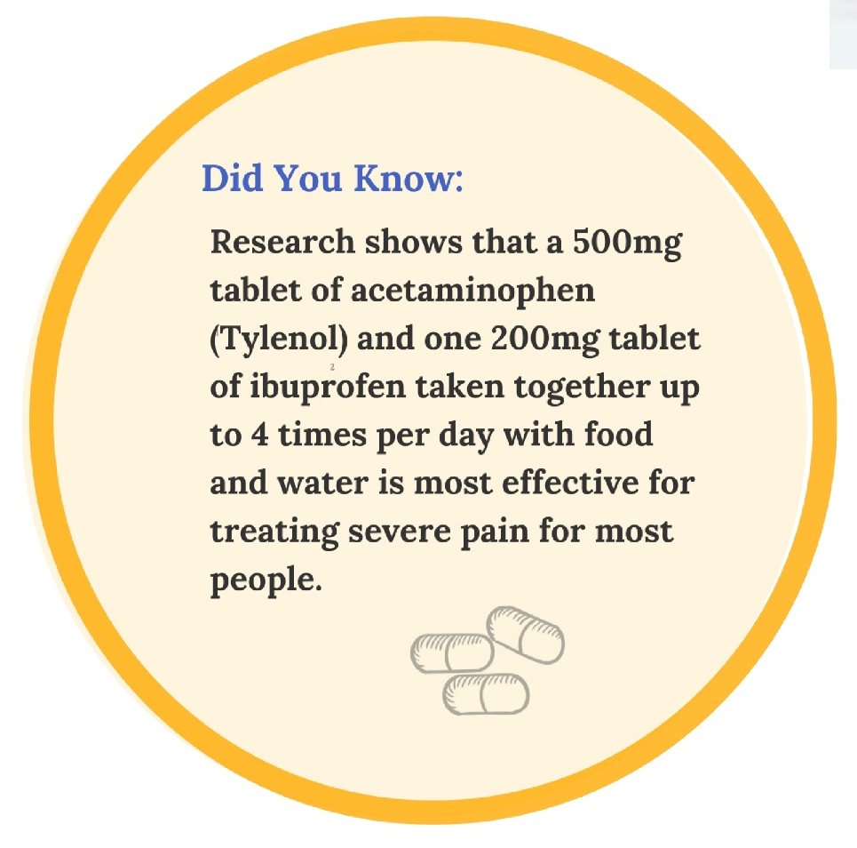
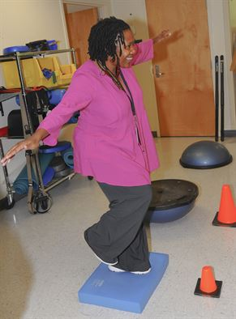

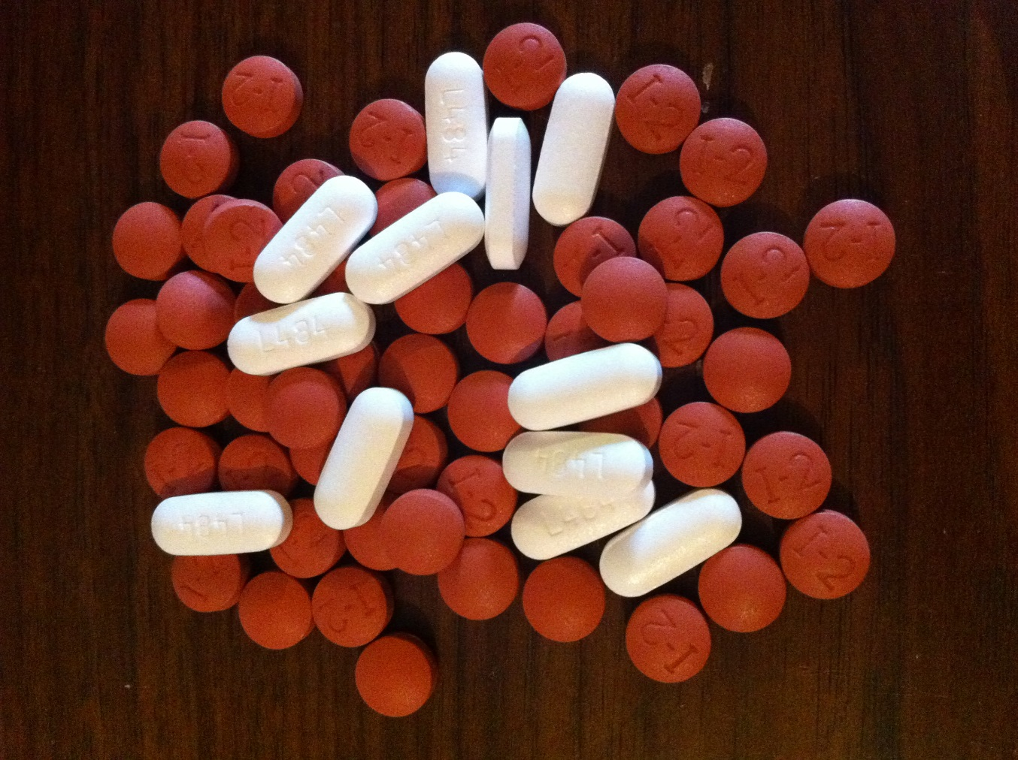
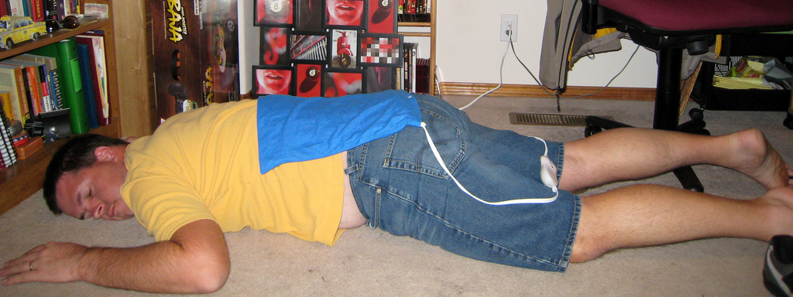

Slide 24
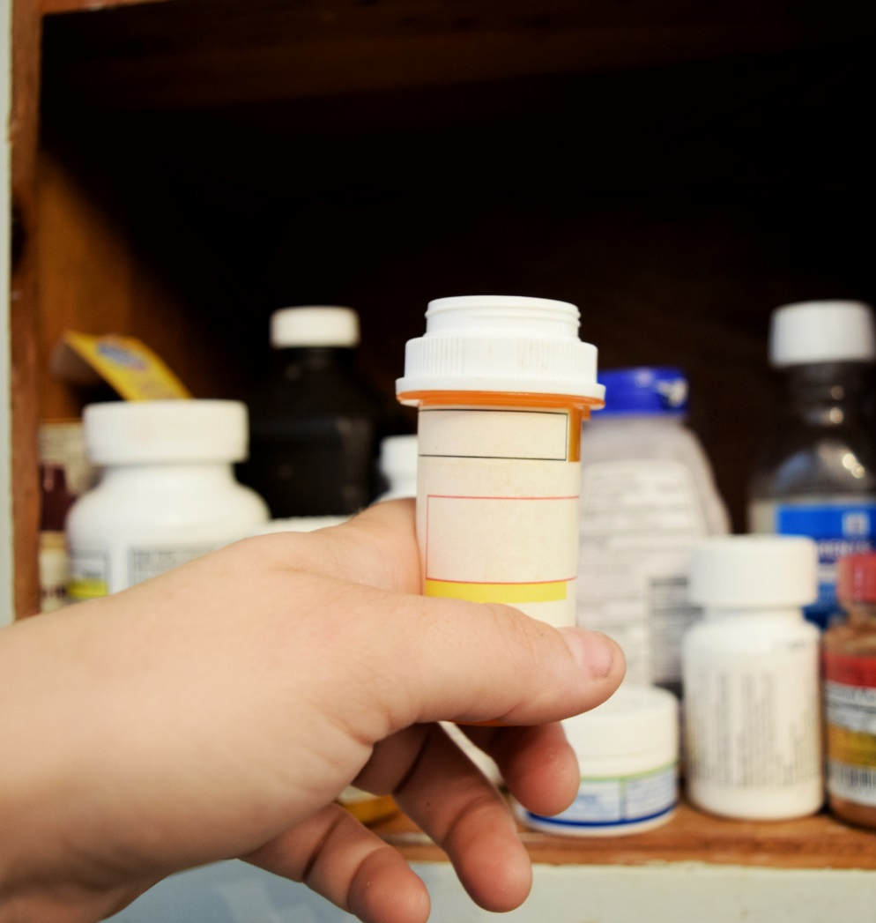
Simple steps to help:
Count the number of painkillers in your home
Secure your pills
Drop off unused pills at a RX Drop-Off Location
Ask your friends & family to do the same
Notes:
We are all at risk, especially our children. Most abused prescription drugs come from family and friends. You could be a drug dealer without even knowing it.
Everyone in Buncombe County should take the following steps:
Count the number of painkillers in your home
Secure your pills
Drop off unused pills at a RX Drop-Off Location
Ask your friends & family to do the same

Slide 25
Safely Dispose of Your Prescription Drugs
The lobby of the Buncombe County Sheriff’s Office at 339 New Leicester Hwy
The Buncombe County Courthouse at 60 Court Plaza
Lobby of the Asheville Police Department at 100 Court Plaza
Notes:
There are three prescription drug drop boxes in Buncombe County. They are located:
the lobby of the Buncombe County Sheriff’s Office at 339 New Leicester Hwy,
the lobby of the County Courthouse at 60 Court Plaza,
the lobby of the Asheville Police Department at 100 Court Plaza.
When dropping off medications, please follow these instructions:
remove identification from all medications.
separate pill, liquids and inhalers.
use a different disposal paper or plastic bag for each type of medication.
empty dry pill medications into a bag
leave liquid medications in their original container and place in a separate bag
NO radioactive medications such as cancer medications, needles or sharpes accepted.

Slide 26
3 ways each of us can help:
Decrease the number of painkillers in use in our community. Ask your doctor for other ways to deal with pain. Secure your painkillers. Safely dispose unused painkillers.
Talk about this as a health epidemic to your children and friends
Know the signs and symptoms of addiction and help those who are addicted to get help

Slide 27
…
What will you do to stop this epidemic?

Slide 28
Conversation Guide:
What surprised you about the information provided in this presentation?
What scares you the most?
What gives you hope?
What will you do to stop this epidemic?

Slide 29
Combatting the Epidemic:
The epidemic of prescription painkiller addiction is everywhere in our community and we all have a role in stopping it.
Opioids, or painkillers include:
Oxycodone
Codeine
Fentanyl
Risk Factors Include:
Symptoms of trauma - Stress, depression
Access to an addictive substance
Starting alcohol, nicotine or other drug use at an early age
Engaging in sexual relations at an early age is associated with addiction
How to fight this epidemic:
Talk to your children: Children who learn about the risks of drugs at home are 50 percent less likely to use drugs
Find other ways to relieve pain: Research shows that a 500 mg tablet of acetaminophen and one 200 mg tablet of ibuprofen taken together up to 4 times per day with food and water is most effective for treating severe pain for most people.
Count the number of painkillers in your home
Secure your pills
Drop off unused pills at a RX Drop-Off Locations:
Buncombe County Sherriff's Office- Downtown Asheville- County Courthouse
Asheville Police Department
Ask your friends and family members to discard unused medications
Talk about this as a health epidemic to your children and friends. Addiction is not a moral failure, it is a disease of the brain.
Know the signs and symptoms of addiction
Call 911- Good Samaritan laws provide protection
Vicodin
Heroin
Know what to look for:
Changes in mood, grades, weight, and low energy for practices, games, school, or team activities.
Withdrawn or depressed
Makes endless excuses
Exhibits uncharacteristically loud, obnoxious behavior
Unkempt, dirty appearance
It only takes a little to lose a lot:
Prescription painkillers are highly addictive. For some it can take only a week to become addicted. Prescription painkillers can lead to use of other non-prescription drugs.
In Buncombe County:
Over 17 million painkillers were prescribed in 2015 in Buncombe County.
399 babies were delivered at Mission with substances in their system. The majority of children in foster care have a parent that struggles with addiction.
If you need help with substance use:
Vaya Health- Call 1-800-849-6127 for 24/7 help with services and support for mental health and substance abuse
Did you know:
Drug abuse starts early. More than 90% of adults with substance use disorders started using before age 18. Drug abuse can be related to trauma such as abuse, neglect, mental illness, incarceration, and divorce.
Narcan can save the life of a person experiencing an overdose. If someone you love uses opioids get a kit and get trained to use it while you get them into treatment. Visit www.thesteadycollective.org for information on harm reduction in Buncombe County

