Slide 1
School Capital Fund Commission
July 13, 2020

Slide 2
Agenda
Call to Order
Approval to follow agenda as presented
Approval of October 21, 2019 Meeting Minutes
Approval of June 5, 2020 Special Meeting Minutes
Public Comment
Commission Member Discussion and Appointments
Financial Update
Schedule of Future Meetings
Adjournment

Slide 3
Public Comment

Slide 4
Appointments

Slide 5
Current Appointments
Max Queen – Board Member, BCS – Expires 8/2020 (Term 1)
  Buncombe County Schools Representative
Charlotte Sullivan – Finance Director, Land of Sky – Expires 8/2020 (Term 1)
  Asheville City School Representative
Brownie Newman – Chair, BOCC – Expires 8/2020 (Term 2)
  Buncombe County Appointed Representative
Joe Belcher – Board Member, BOCC - Expires 8/2020 (Term 1)
  Buncombe County Appointed Representative
Gene Bell – Retired Exec. Director, Asheville Housing Authority - Expires 8/2020 (Term 2)
  SCFC Appointment
Notes:
All current member appointments/terms expire in August 2020

Slide 6
Financial Update

Slide 7
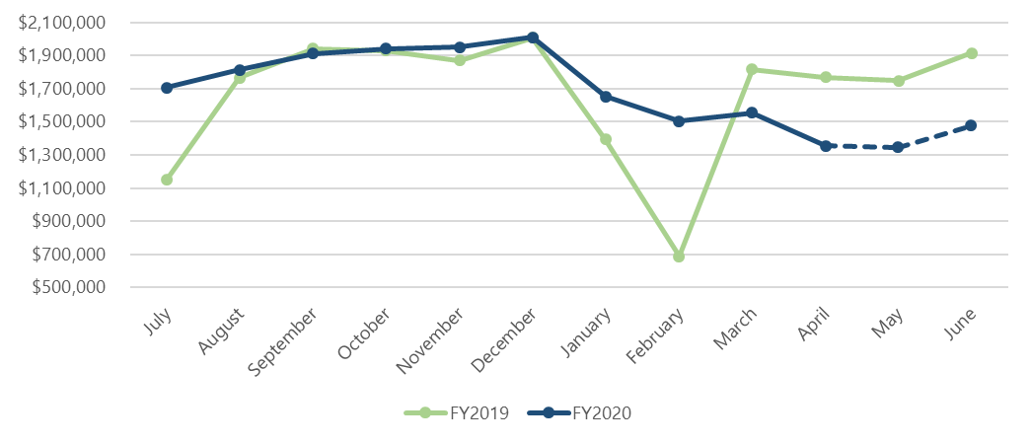
Financial Update
Article 39 Sales Tax & Debt Issuance
Article 39 Sales Tax (50%) FY20 vs. FY19
For FY2020, initially estimated ~$20.4M total in Sales Tax Revenue. Now revised estimate to ~$20.2M total. -24% in March revenues, year over year.
Buncombe County Finance will continue monitoring Sales Tax in anticipation of upcoming funding cycle.
Planned debt issuance was successful – 2019 and 2020 projects. $17M in approved projects from past October will be included in future issuances.

Slide 8
Schedule of Future Meetings

Slide 9
Future Meetings & Dates
July 13, 2020
August 10, 2020 - ?
September 14, 2020
October 12, 2020
February 8, 2021
March 8, 2021
Notes:
In FY2020, we cancelled the August meeting

