Slide 1
Stressors and Coping Skills
Justice Resource Center

Slide 2
What is stress?
“Stress is how the brain and body respond to any demand. Any type of challenge—such as performance at work or school, a significant life change, or a traumatic event—can be stressful”.
“Stress can affect your health. It is important to pay attention to how you deal with minor and major stressors, so you know when to seek help”
(https://www.nimh.nih.gov/health/publications/stress/index.shtml)

Slide 3
Perception
Stress and trauma are rooted in perception
No two people will experience a stressor the same
Each person perceives stress in their own way due to many different factors

Slide 4
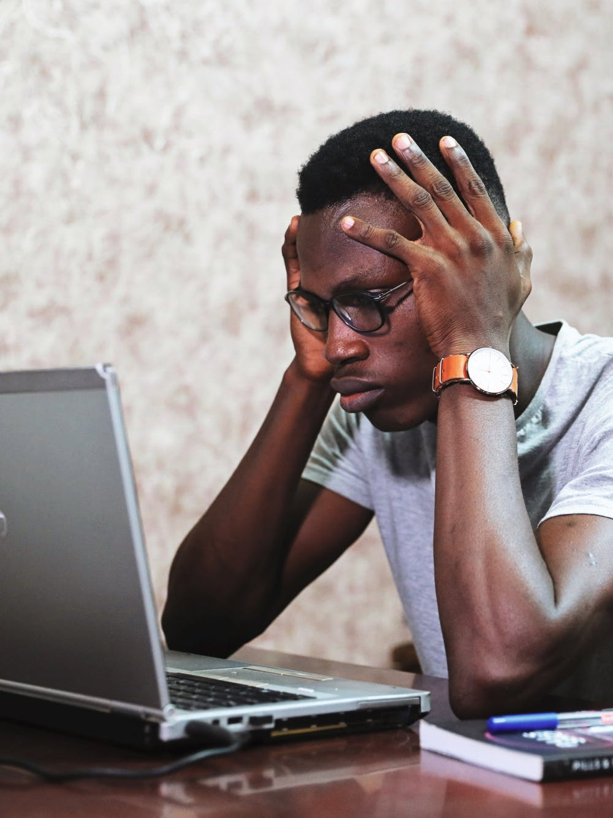
What does stress feel like to the body?
Shallow breathing
Pounding heart
Tense muscles
Nausea or upset stomach
Sweaty palms
Rise in temperature
What else?

Slide 5
Role of the Brain
One way to simplify our understanding of the brain is to think of our brain in 3 parts: Thinking, Emotional and Survival
Dr. Dan Seigel, pared down the human brain using the hand brain model to simplify how we understand how our brain reacts to stress

Slide 6
Role of the Nervous system
Our Autonomic Nervous System consist of our sympathetic nervous system and our parasympathetic nervous system
Sympathetic Nervous system
Stress response
Parasympathetic nervous system
“rest and digest”

Slide 7
Getting Stuck
If a person spends more time activated by my sympathetic nervous system, I can feel stuck there
A person can begin to feel that the world is dangerous
A person can feel as though we need to protect ourselves at all times
A person can misread social cues and faces
A person can miss signs of safety
(Deb Dana The Polyvagal Theory in Therapy: Engaging the Rhythm of Regulation)

Slide 8
Role of the nervous system
We can be consistently working to create flexibility in our nervous system
The more we practice awareness of what we are experiencing the more capable we become of moving into a different state
It is the little things that we do regular that have the biggest effect on making our nervous system more flexible

Slide 9
Managing Stress with Self Soothers and Coping Skills

Slide 10
Key Factors in addressing Toxic Stress
Dr. Nadine Burke Harris has identified the following factors:
Sleep
Exercise
Nutrition
Mindfulness
Mental health
Healthy relationships
https://www.motherjones.com/politics/2017/07/the-opioid-epidemic-is-literally-changing-kids-brains/

Slide 11
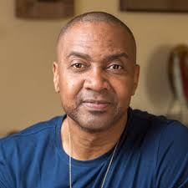
“Growth Routine”
In his book, My Grandmother’s Hands, Resmaa Menakem writes about the importance of creating a “growth routine”
He speaks of the importance of many of the same things that Nadine Burke Harris mentions and also adds others
Simple pleasures (playing an instrument, talking with a friend, going for a walk outside)
You know what is best for you
https://www.psychologytoday.com/us/blog/the-author-speaks/201709/my-grandmother-s-hands

Slide 12
4, 7, 8 Breathing
Inhale and count to 4
Hold in breath until the count of 7
Exhale through pursed lips and count to 8
Repeat pattern 4 times

Slide 13
Zentangles
https://zentangle.com/

Slide 14
Bilateral Tapping
Cross your arms over your chest comfortably
Allow your hands to rest on each opposite upper arm
Use your hands to alternately tap your upper arms
Continue for two minutes

Slide 15
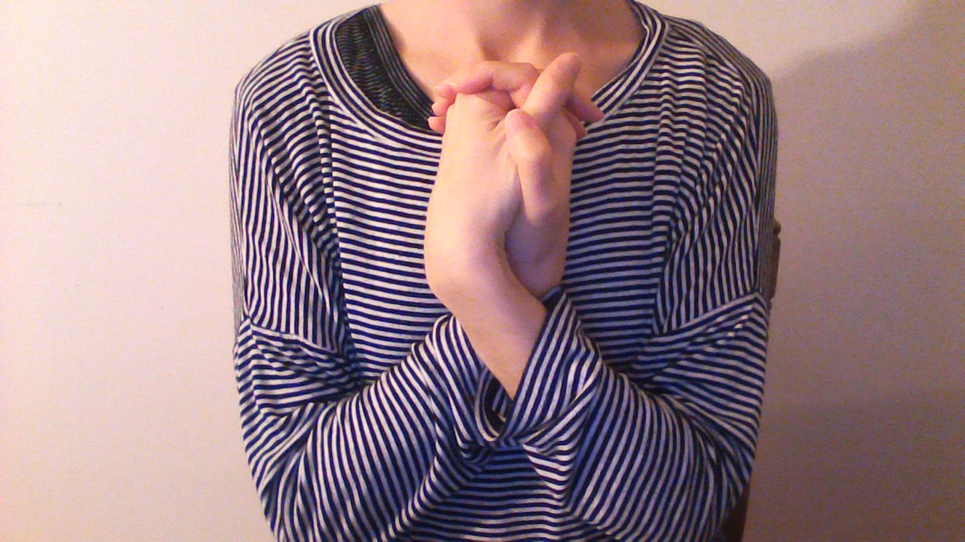
The Pretzel
Cross dominant ankle over non dominant ankle
Arms straight out in front of you, palms facing each other
Turn your thumbs down and your palms outward
Cross dominant hand over non dominant hand
Lace fingers
Drop your joined hands down and push your elbows out
Bring joined hands down and then through your arms and up to rest on your chest

Slide 16
Thank you
Please don’t hesitate to reach out if you have any questions or concerns
You can call or email
Shawna.ohle@buncombecounty.org
828-250-6412

Slide 17
References
Polyvagal Theory in Therapy: Engaging the Rhythm of Regulation written by Deb Dana, LCSW
My Grandmother’s Hands: Racialized Trauma and the Pathway to Mending our Hearts and Bodies written by Resmaa Menachem MSW, LICSW, SEP
The Deepest Well: Healing the Long Term Effects of Childhood Adversity written by Nadine Burke Harris, M.D.
https://www.nimh.nih.gov/health/publications/stress/index.shtml
https://www.youtube.com/watch?v=gm9CIJ74Oxw
https://www.youtube.com/watch?v=DL-8iqkGpFE&t=9s

