Slide 1
Acceptance and Commitment Therapy
Justice Resource Center

Slide 2
Core Processes of ACT
Acceptance/willingness
Values
Committed Action
Present moment
Self as context
Diffusion

Slide 3
Acceptance/Willingness
What do we tend to do when we feel something that we don’t want to feel?

Slide 4
If I feel rejection, I might…
Isolate
Use social media to distract
Get angry
Pretend like I don’t care
Watch tv
Have a drink
Self sabotage
Tell myself I’m not good enough
And the list goes on and on…

Slide 5
Isolate
Use social media to distract
Get angry
Pretend like I don’t care
Watch TV
Have a drink
Self sabotage
Tell myself I’m not good enough
And the list goes on and on…
Feeling rejection

Slide 6
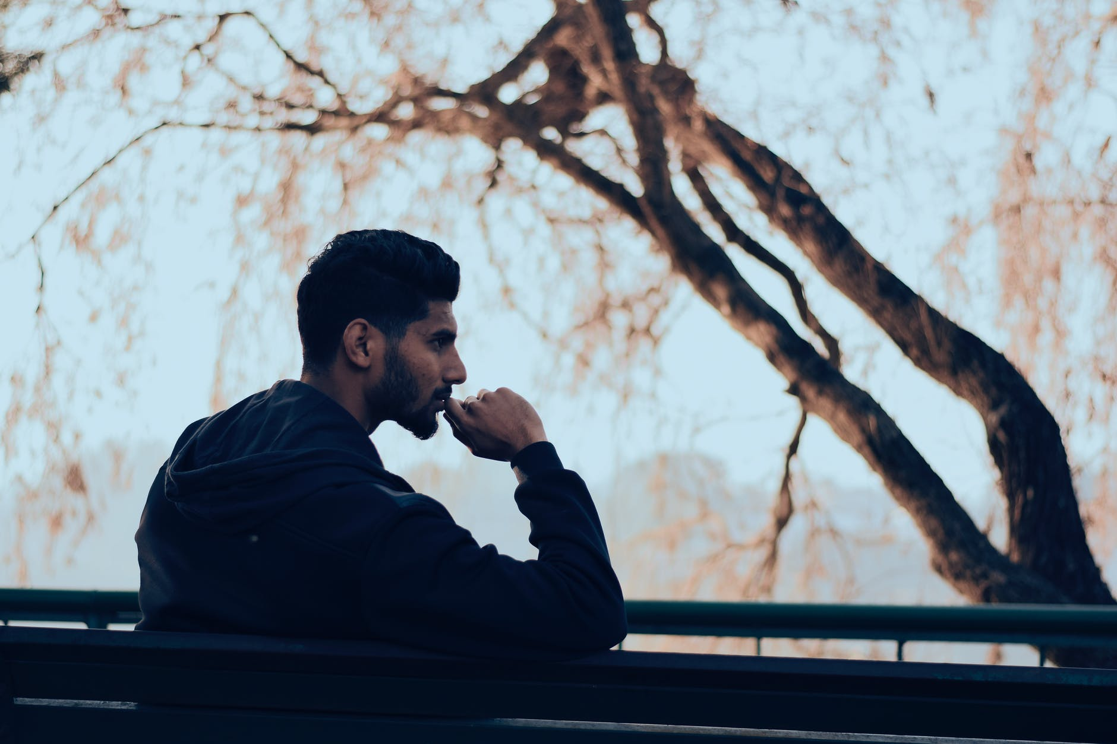
Control and Avoidance
What if we spend so much time avoiding that we never realize what we value in life because we are so invested in not feeling?

Slide 7
Control and Avoidance
Sometimes experiential avoidance can be harmful causes us to engage in ways that go against what we want to happen
Sometimes when we try to regulate our private thoughts they can take on more control

Slide 8
Experiential Control
The tendency to try and control our experiences, may not be an effective means to address our feelings
Sometimes what we do to avoid negative thoughts and feelings creates additional suffering

Slide 9
Experiential Control and Experiential Avoidance
Sometimes we can avoid things, but the way we choose to avoid is unhealthy, expensive, or harmful to our lives
Sometimes we are avoiding something that is important

Slide 10
Acceptance/Willingness
There is ALWAYS a choice with willingness
Especially in this setting, it may not be safe or helpful to practice willingness all the time and that is perfectly fine

Slide 11
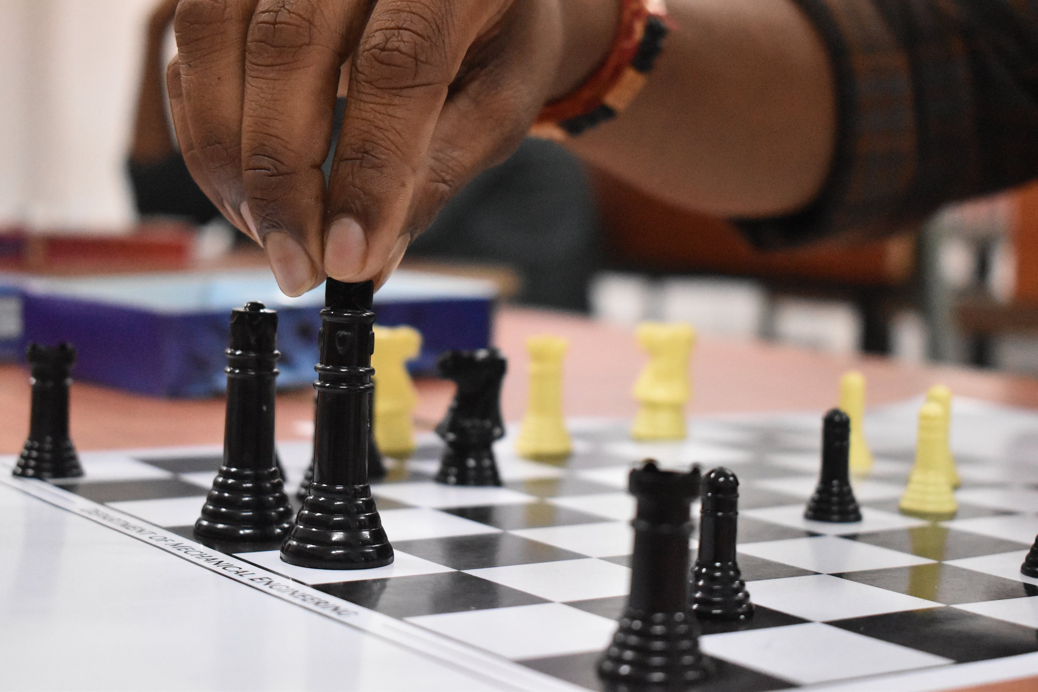
Acceptance/Willingness
We can choose
Maybe we will practice on one emotion and not another
Maybe we will be willing certain times of day
Maybe we will be willing for an hour each day or 20 minutes each day

Slide 12
Acceptance/Willingness
Something to be learned
Rewiring our brains
Loss of experiential control can be a challenge
Use safe coping skills and grounding to help
Willingness is self-validation
When we are no longer being avoidant we are being more ourselves
Non-judgmental awareness (mindfulness)

Slide 13
When suffering knocks at your door and you say there is no seat for him, he tells you not to worry because he has brought his own stool.
Chinua Achebe from Arrow of God

Slide 14
Values
What do you, personally, value?
How often do you think about what you value?
How often do your values inform your behaviors?

Slide 15
Examples of some values
Courage
Humor
Humility
Kindness
Adventure
Curiosity
Honesty
Gratitude
Independence
Open mindedness
Persistence
Respect
Freedom
Fitness
Equality
Caring
Connection
Fun
Independence
Responsibility
Safety
Trust
Patience
Generosity
Creativity
Cooperation
The list goes on and on

Slide 16
Committed Action
We always have the capacity to respond by enacting our values
If our values are our compass, then committed actions are our steps
Helps us to carry on

Slide 17
Committed Action
We can focus on our values rather than avoiding negative feelings and sensations
Self-talk
“What’s the point?”
“I’ll never be able to do that anyway”
We can allow our values to point us in the right direction rather than allowing negative thoughts to direct us

Slide 18
Committed Action
Each action is a choice
Each committed action is a chance to pursue a life based on our values

Slide 19
What are the barriers to committed action?
If we are constantly escaping our negative experiences we may not to take committed actions because they may evoke negative feelings, thoughts, sensations or images.
When we value love we risk loss
When we value community we risk rejection

Slide 20
Our true home is the present moment
Thich Nhat Hanh

Slide 21
Present Moment
We can fuse with thoughts about our future and thoughts about our past which pulls us away from the now
This doesn’t mean that we should never be thinking about the future or the past rather, we can be present when being present works best, we can think about the future when we need to plan and we can think about the past when we need to remember

Slide 22
Present Moment
It is practice experiencing feelings in the moment rather than fighting against a feeling and causing harm
Living in the present moment encourages us to show up for our own lives
We are stepping out of our world of thought and into our present moment
How does mindfulness relate to willingness and values?

Slide 23
Present Moment
Mindfulness impacts how we think about ourselves
When we connect with the present moment we can create a more flexible sense of self
We can develop a sense of self as our self as a process
What do you think it means to understand yourself as a process?
What effect might this have?

Slide 24
Mindfulness and well being
More likely to appreciate life as it occurs
Helps us become more engaged
Enhances our resilience
We become less preoccupied
We are more likely to connect with others

Slide 25
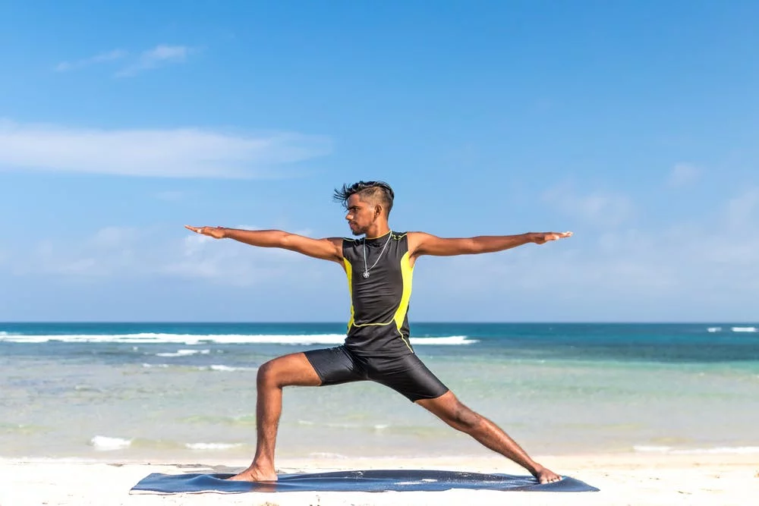
Mindfulness and Physical Health
Relieves stress
Lower blood pressure
Reduce chronic pain
Improve sleep
Improves gastrointestinal complications

Slide 26
Mindfulness and mental health
Can help with
depression
substance abuse
eating disorders
anxiety disorders
obsessive-compulsive disorder

Slide 27
Go with the flow
We don’t have to work to change anything or have the “perfect conditions” to be mindful. We can simply pay attention to our own sensations, emotions and thoughts. Remain neutral as we notice our moment to moment experience. It can be challenging not to become fixated on a particular variable, or to start thinking about the past or the future. Through bringing attention back to the present moment we can begin to recognize the effects of specific sensations, thoughts and emotions.

Slide 28
Stay with it
It is okay to feel frustrated by the process at first. The more we practice the more habitual it will become.
If you choose to practice mindfulness, how might you practice it?

Slide 29
Thank you!
Please don’t hesitate to reach out if you have any questions or concerns
You can call or email
Shawna.ohle@buncombecounty.org
828-250-6412

