Slide 1
Safety and Justice Challenge Update
Lisa Sousa, SJC Grant Manager
Justice Services Department

Slide 2
Outline
Background
Safety and Justice Challenge History and Budget
Jail Population Data
Strategies Overview
Increase Efficiencies in Case Processing
Advancing Racial Equity
Increase Community Engagement

Slide 3
Safety and Justice Challenge Grant Update
The Safety + Justice Challenge is a national initiative to safely reduce jail populations and eliminate racial inequities in local criminal justice systems.
The Challenge Network represents 57 counties, cities and states across the country.

Slide 4
2016: $50,000 Innovation Grant
2018: $1.75M Implementation Award
2021: $1.75M Renewal Award
2023: $1.1M Sustainability Award

Slide 5
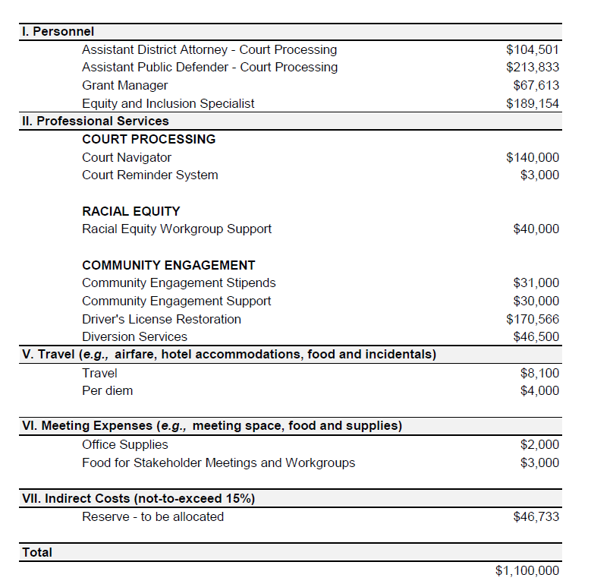
Safety and Justice Challenge Sustainability Grant 04/01/23-03/31/25

Slide 6
SJC Funded Positions
County Positions
Contracted Positions
1 Equity & Inclusion Specialist
1 Grant Manager
1 Assistant Public Defender
1 Assistant District Attorney
1 Attorney for Driver’s License Restoration and Expunction
1 Legal Assistant for Driver’s License Restoration and Expunction (supplementary funding provided by County)
1 Court Navigator

Slide 8
Buncombe County Jail Population Goals
Local Average Daily Population
Racial Disparities
Original target:
327 monthly ADP
How we’re doing:
405 ADP
for 7/18/23 – 9/16/23
Percentage of local jail population that is Black:
Goal = 6%
On 9/17 = 31.2%

Slide 9
Safety and Justice Challenge Strategies
Increase Efficiencies in Case Processing
Increase Community Engagement
Advancing Racial Equity
Continue Jail Review Team
Increase early access to defense counsel
Continue Racial Equity Workgroup
Partner with community to identify root causes driving increasing racial inequities and co-design solutions
Increase community understanding of justice system
Use Racial Equity Tool
Increase use of court notification system
Ongoing education and training
Partner with community to identify root causes and develop interventions to address drivers of incarceration, Support establishment of Driver’s License Restoration Initiative
Continue Case Processing Workgroup
Continue Community Engagement Workgroup
Notes:
To achieve these goals, five strategies have been proposed:
Enhancing Pretrial Release Strategies (ongoing)
Increasing Efficiencies in Case Processing (ongoing);
Advancing Racial Equity (ongoing);
Increasing Community Engagement (ongoing); and
Advancing Community Safety and Violence Prevention
This strategy is starting in the fall of 2020 and builds off racial equity and community engagement work. The Racial Equity Workgroup identified violent felonies as a primary driver of inequities in length of stay. We also know violence disproportionately impacts Black communities in Buncombe County. Approximately 63-71% of gun violence victims in Asheville are Black. Community members have voiced a desire for community-led approaches to support safety in their communities, and there is strong interest from various SJC partners – including leadership from Asheville Police Department, Asheville Housing Authority, and the County’s Child Fatality Review Team – to address community safety and violence prevention.
To achieve these goals, five strategies have been proposed :
Enhancing Pretrial Release Strategies builds on existing work to increase the proportion of people released under non-financial conditions by:
moving the PSA to the magistrates when allowable per COVID requirements;
maintaining the use of non-financial release conditions at the levels seen during COVID and focusing specifically on individuals charged with non-violent offenses;
pursuing diversion options, especially for those with substance use issues, and continuing to provide treatment linkages to those in need through continuing jail-based substance use disorder diversion; and
working with stakeholders to identify the possibilities and needs for pre-arrest and jail diversion strategies, including the expanded use of citations.
Increasing Efficiencies in Case Processing includes ongoing activities and new efforts implemented as a part of COVID response, including:
continuing the Jail Review Team and expanding its focus to include criteria for unsecured bonds and parameters for detention, reviewing cases for early release of sentenced inmates, alternatives for failure to appear, higher level charges, and people staying in custody for longer periods of time;
engaging in a robust promotional campaign for the use of the state’s court notification system; and
increasing early access to defense counsel.
Advancing Racial Equity builds upon the foundation laid during the first round of SJC funding by:
hiring a racial equity coordinator to champion collaborative racial equity work;
expanding data analysis and the review of policies and practices using the Racial Equity Workgroup’s equity tool;
continuing to provide education and training opportunities to stakeholders;
conducting root cause analyses to understand why racial inequities have increased in the jail population during the pandemic; and
partnering with community members to identify root causes driving already identified inequities and co-designing solutions and interventions.
Increasing Community Engagement builds on the work and relationships developed during the first round of SJC implementation. Planned activities include:
conducting community outreach and providing education about what happens when you fail to appear in court, drive without a license, or fail to pay a fine or fee;
supporting the establishment of Drivers' License Restoration Initiative;
increasing community understanding with the court system through education, court observations, participatory mapping of how people move through the system, and partnering with community organizations on events;
partnering with community to develop interventions that address drivers of incarceration, including failures to appear and violent crime; and
partnering with community organizations to address community safety.
Advancing Community Safety and Violence Prevention: This strategy is new and builds off racial equity and community engagement work. The Racial Equity Workgroup identified violent felonies as a primary driver of inequities in length of stay. We also know violence disproportionately impacts Black communities in Buncombe County. Approximately 63-71% of gun violence victims in Asheville are Black. Community members have voiced a desire for community-led approaches to support safety in their communities, and there is strong interest from various SJC partners – including leadership from Asheville Police Department, Asheville Housing Authority, and the County’s Child Fatality Review Team – to address community safety and violence prevention. Activities to implement and sustain this strategy include:
working with community partners to address community violence;
identifying strategies to address violence, including community-led initiatives and law enforcement practices that have reduced violent crime in other communities, with the goal of developing pathways to reduce harm and work towards healing in our community;
engaging stakeholders in a collaborative and coordinated response to gun-violence and increasing recognition of violence as a problem in our community; and
infusing intergenerational and whole family support approaches into the work of community safety and violence prevention.

Slide 10
Strategy: Advancing Racial Equity
Racial Equity Workgroup (meets monthly, has been on hiatus)
Culturally Aligned Counseling
Education & Training
Driver’s License Restoration Program and Debt Relief Pilot
Ethnicity Collection Project

Slide 11
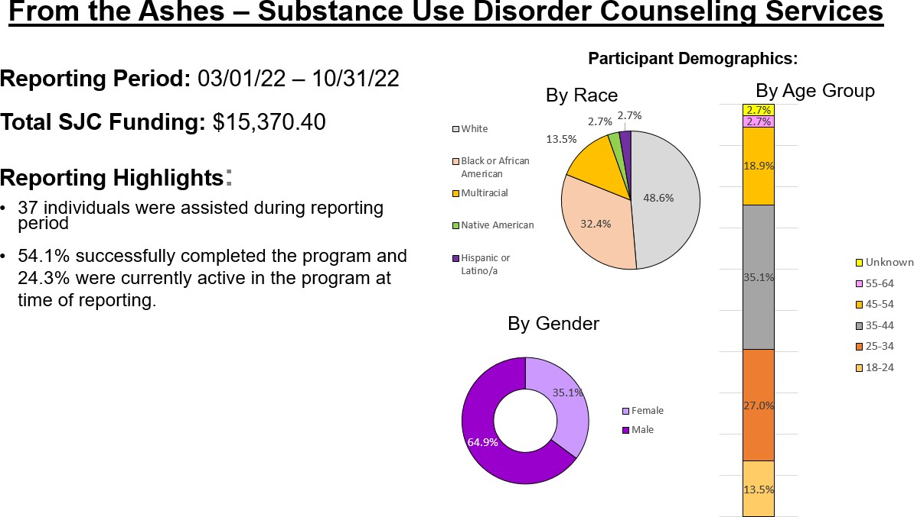
Culturally Aligned Counseling
Partnered with From the Ashes, an African American counseling service, to provide substance use disorder counseling to high-risk clients.
This service is now offered across all Justice Service programs.

Slide 12
Collaborative Civility Training
Justice Services partnered with the City of Asheville to sponsor the third pilot of Civility Training, a training developed by National Institute for Racial Equity (NIFRE) to improve relationships between the community and law enforcement.
In 2022, three sessions were held averaging 20 participants each. The trainings were led by the former Chief of Police of Black Mountain and included participation by City of Asheville’s Chief of Police, David Zack.
Participants learned about the history of policing in the United States. Group activities focused on understanding pressures and trauma experienced by law enforcement, as well as law enforcement understanding community members encounters with police. The City of Asheville picked up this training.

Slide 13
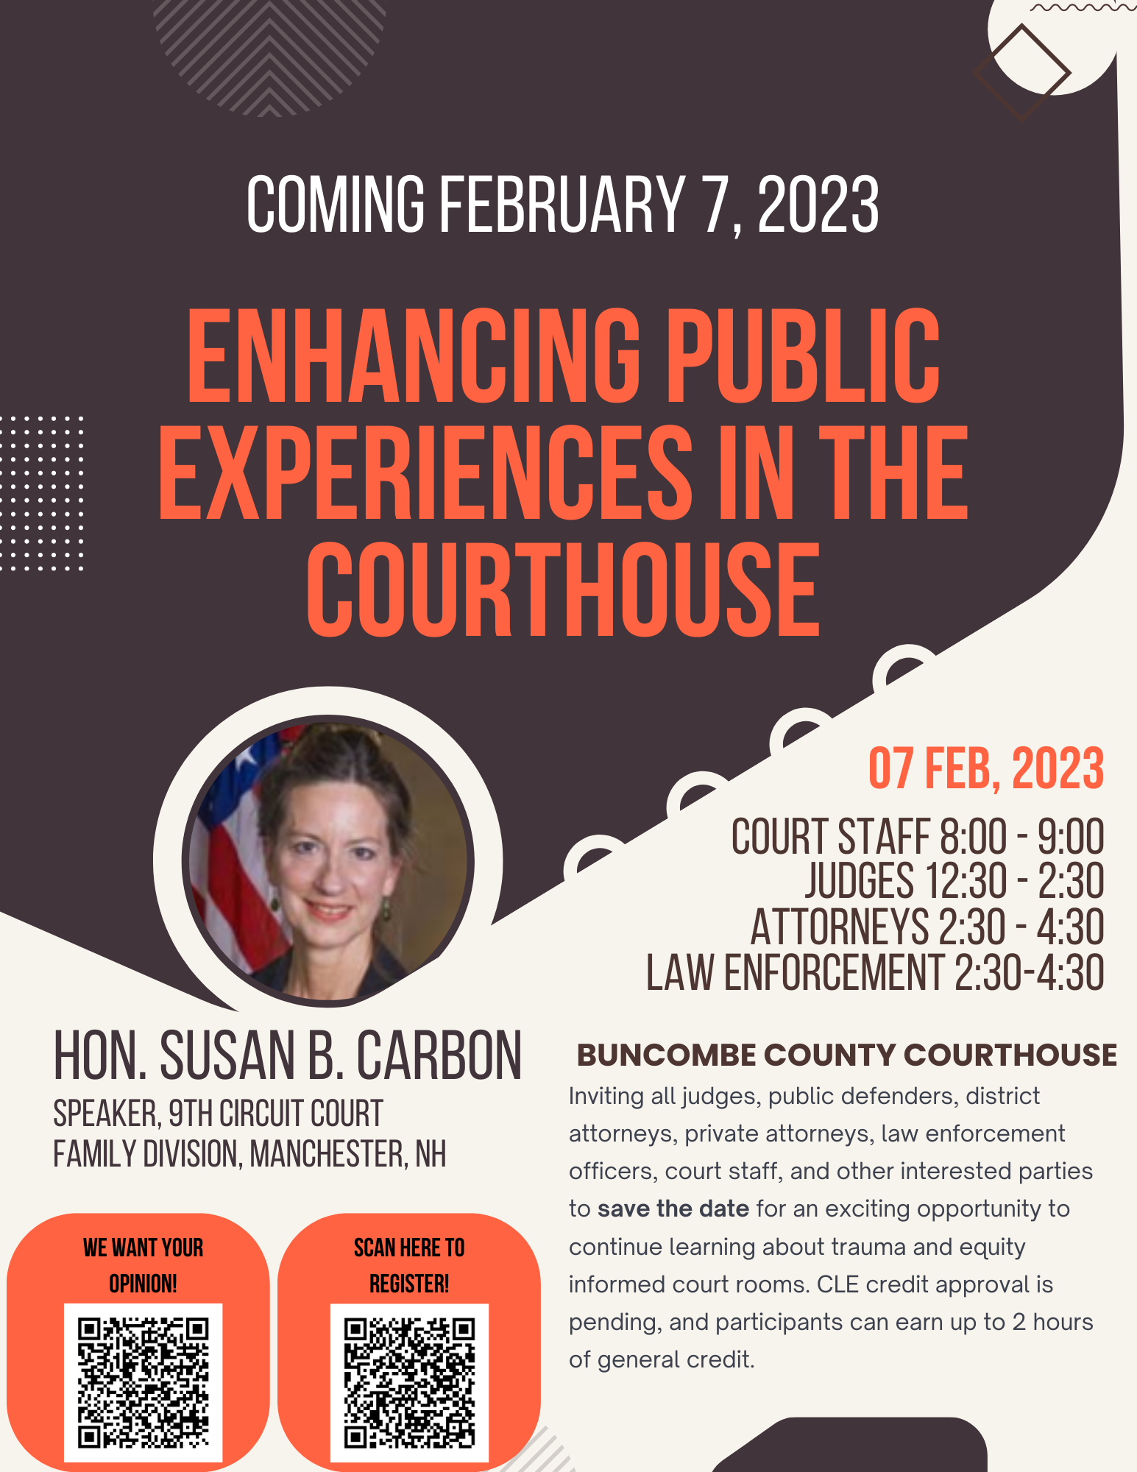
Trauma-Informed Training: Enhancing Public Experiences in the Courthouse
The Racial Equity Workgroup provided a trauma-informed training entitled, Enhancing Public Experiences in the Courthouse on February 7, 2023, with 34 participants including 6 judges.
The training was provided by Circuit Court Judge Susan B. Carbon, who is a nationally recognized expert on domestic violence and former Director of the Office on Violence Against Women at the U.S. Department of Justice.
The purpose of the training was to further Buncombe County's efforts to create a trauma- informed culture that enhances physical and emotional safety in the courthouse.

Slide 14
Driver’s License Restoration Program & Debt Relief Pilot Project
In partnership with Pisgah Legal Services
Assists participants who meet income/eligibility guidelines by assisting participants throughout the driver’s license restoration process.
Driver’s license restoration can improve an individual’s eligibility for employment, higher wages, childcare stability, access to healthcare, and can help avoid further involvement in the criminal justice system.
Funds are used to pay remaining Department of Motor Vehicle fines or fees allowing for formal restoration.
Reporting Highlights March 1, 2022 – June 30, 2023
51 individuals were assisted during reporting period
39.7% either obtained a new driver’s license or were eligibility to reapply for driver’s license while 58.6% were awaiting results

Slide 15
Driver’s License Restoration Customer Demographics: March 1, 2022 – June 30, 2023
Utilized funds to assist in the process of Driver’s License restoration for 51 individuals 60.4% (32) identified as White while 32.1% (17) identified as Black or African American
Females accounted for 53.8% (28) while 46.2% (24) were male
Age groups most represented are 31- to 40-year-olds (41.2%) and 51 and older (23.5%)

Slide 16
Ethnicity Data Collection at Detention Center
Detainees whose ethnicity is neither white nor African American is now being collected at the Detention Center.
Through technical assistance from the Burns Institue, Justice Services staff worked with the Identification Bureau and the Buncombe County Detention Center staff to create a field where the demographic data could be collected.
The goal is to use information to develop strategies to ensure we are culturally aliging programing and services.
The below data includes non-white and non-African Americans held in the Detention Center of March 27, 2023:
Ethnicity Description | Number of Clients
OTHER | 269
Blank | 85
UNRESPONSIVE | 22
HISPANIC / LATINO | 18
CHEROKEE | 3
ASIAN | 1
SIOUX | 1
UKRAINIAN | 1

Slide 17
Strategy: Increase Efficiencies in Case Processing
Case Processing Workgroup & Jail Review Team
Court Navigator
Court Reminder System & Awareness Campaign

Slide 18
Case Processing Workgroup
Jail Review Team
Meets Monthly
District Court Judiciary, DA’s Office, PD’s Office, Justice Services, Sheriff’s Dep. County Clerk
To address issues that will increase efficiencies in case processing
Meets Weekly
DA’s Office, PD’s Office, Jail Leadership, Pretrial
To expedite case resolution for individuals in custody

Slide 19
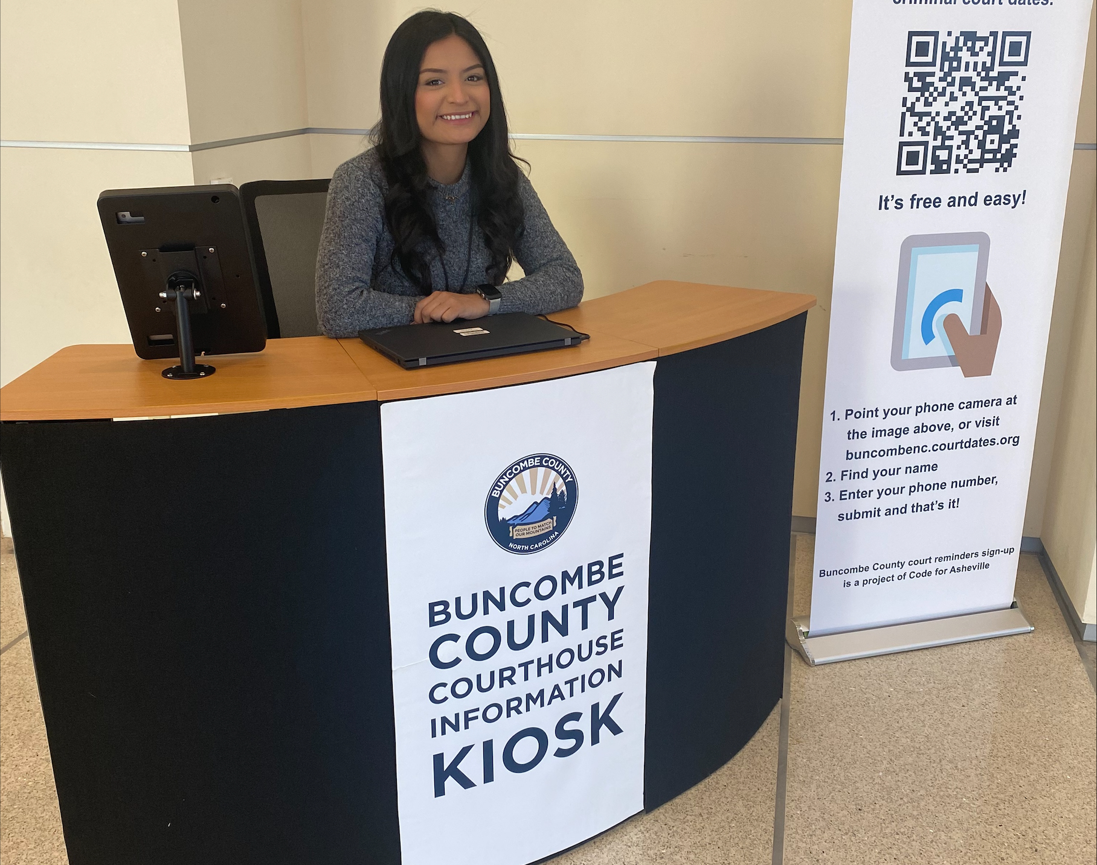
Court Navigator Pilot Program
Located in courthouse lobby. Assists visitors and connects people to JRC programs and other resources.
Signs people up for Court Reminder System.
Ideally, the Court Navigator is bilingual.
Initial goal to serve 200 people within 6 months. During 1st four months served 1774 individuals.

Slide 20
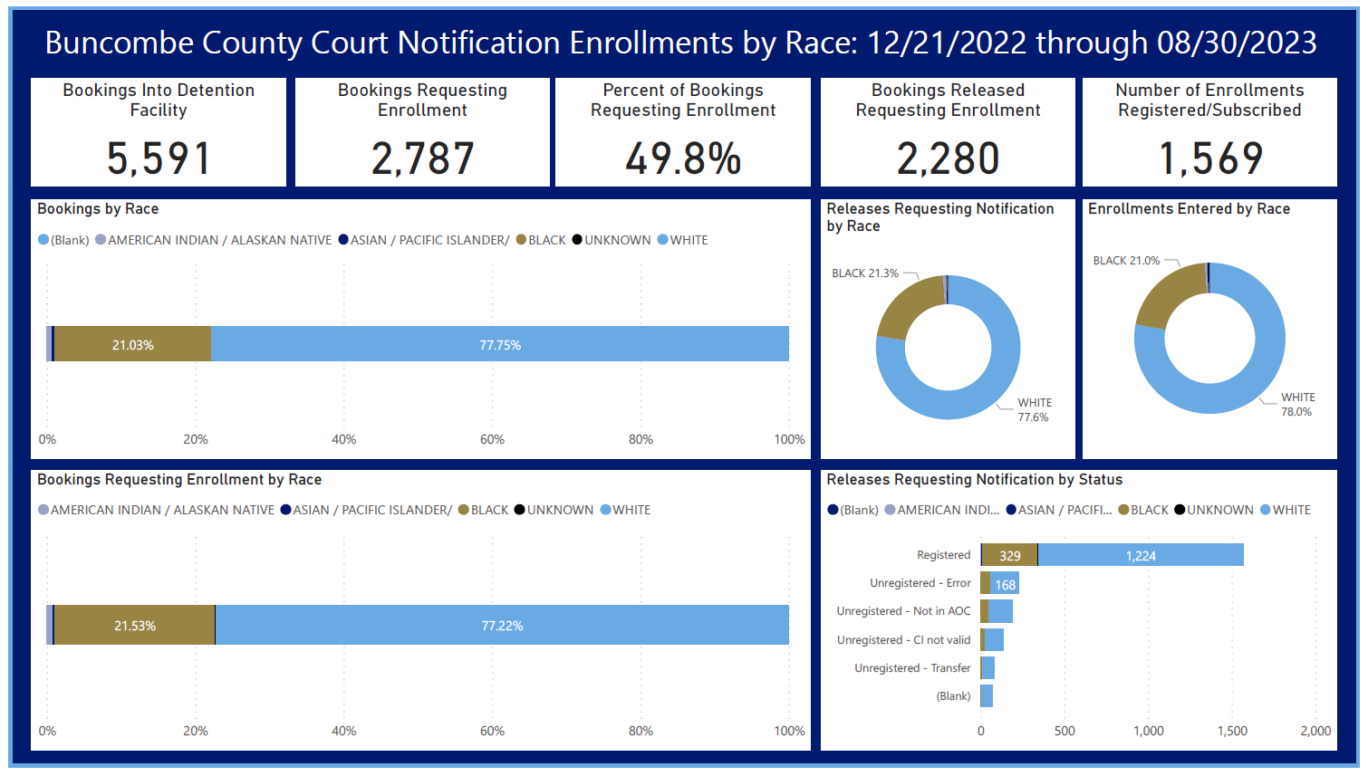
Court Reminder System Enrollment
Increased number of Failure to Appear rates
Under-utilized State notification system
Developed program and process to remind individuals of
their court dates

Slide 21
Court Reminder System & Failure to Appear Awareness Campaign
To increase community awareness about:
Automated court reminder system
Collateral consequences of FTAs
Platforms:
Billboards, Social Media, Radio/TV
Notes:
Provide courthouse wayfinding assistance: information and more detailed assistance as needed
Provide information and/or referral to community resources
Buncombe County Justice Resource Center
justice system partners within the courthouse and/or other community resources
Provide information and registration assistance for the automated court reminder system.
Serve as an employment assistance resource for Justice Services program participants (secondary task)

Slide 22
Strategy: Increase Community Engagement
Community Engagement Workgroup
Outreach Activities
Communications Strategies
Listening Circles

Slide 23
Community Engagement Workgroup
Meets Monthly
Community members, County Stakeholders, DA’s Office, PD’s Office, Law Enforcement, City of Asheville
*Community Outreach & Communication Strategies*
*Conducts listening Sessions in communities*
*Supports Driver’s License Restoration Initiative*
*Increases community understanding of justice system*

Slide 24
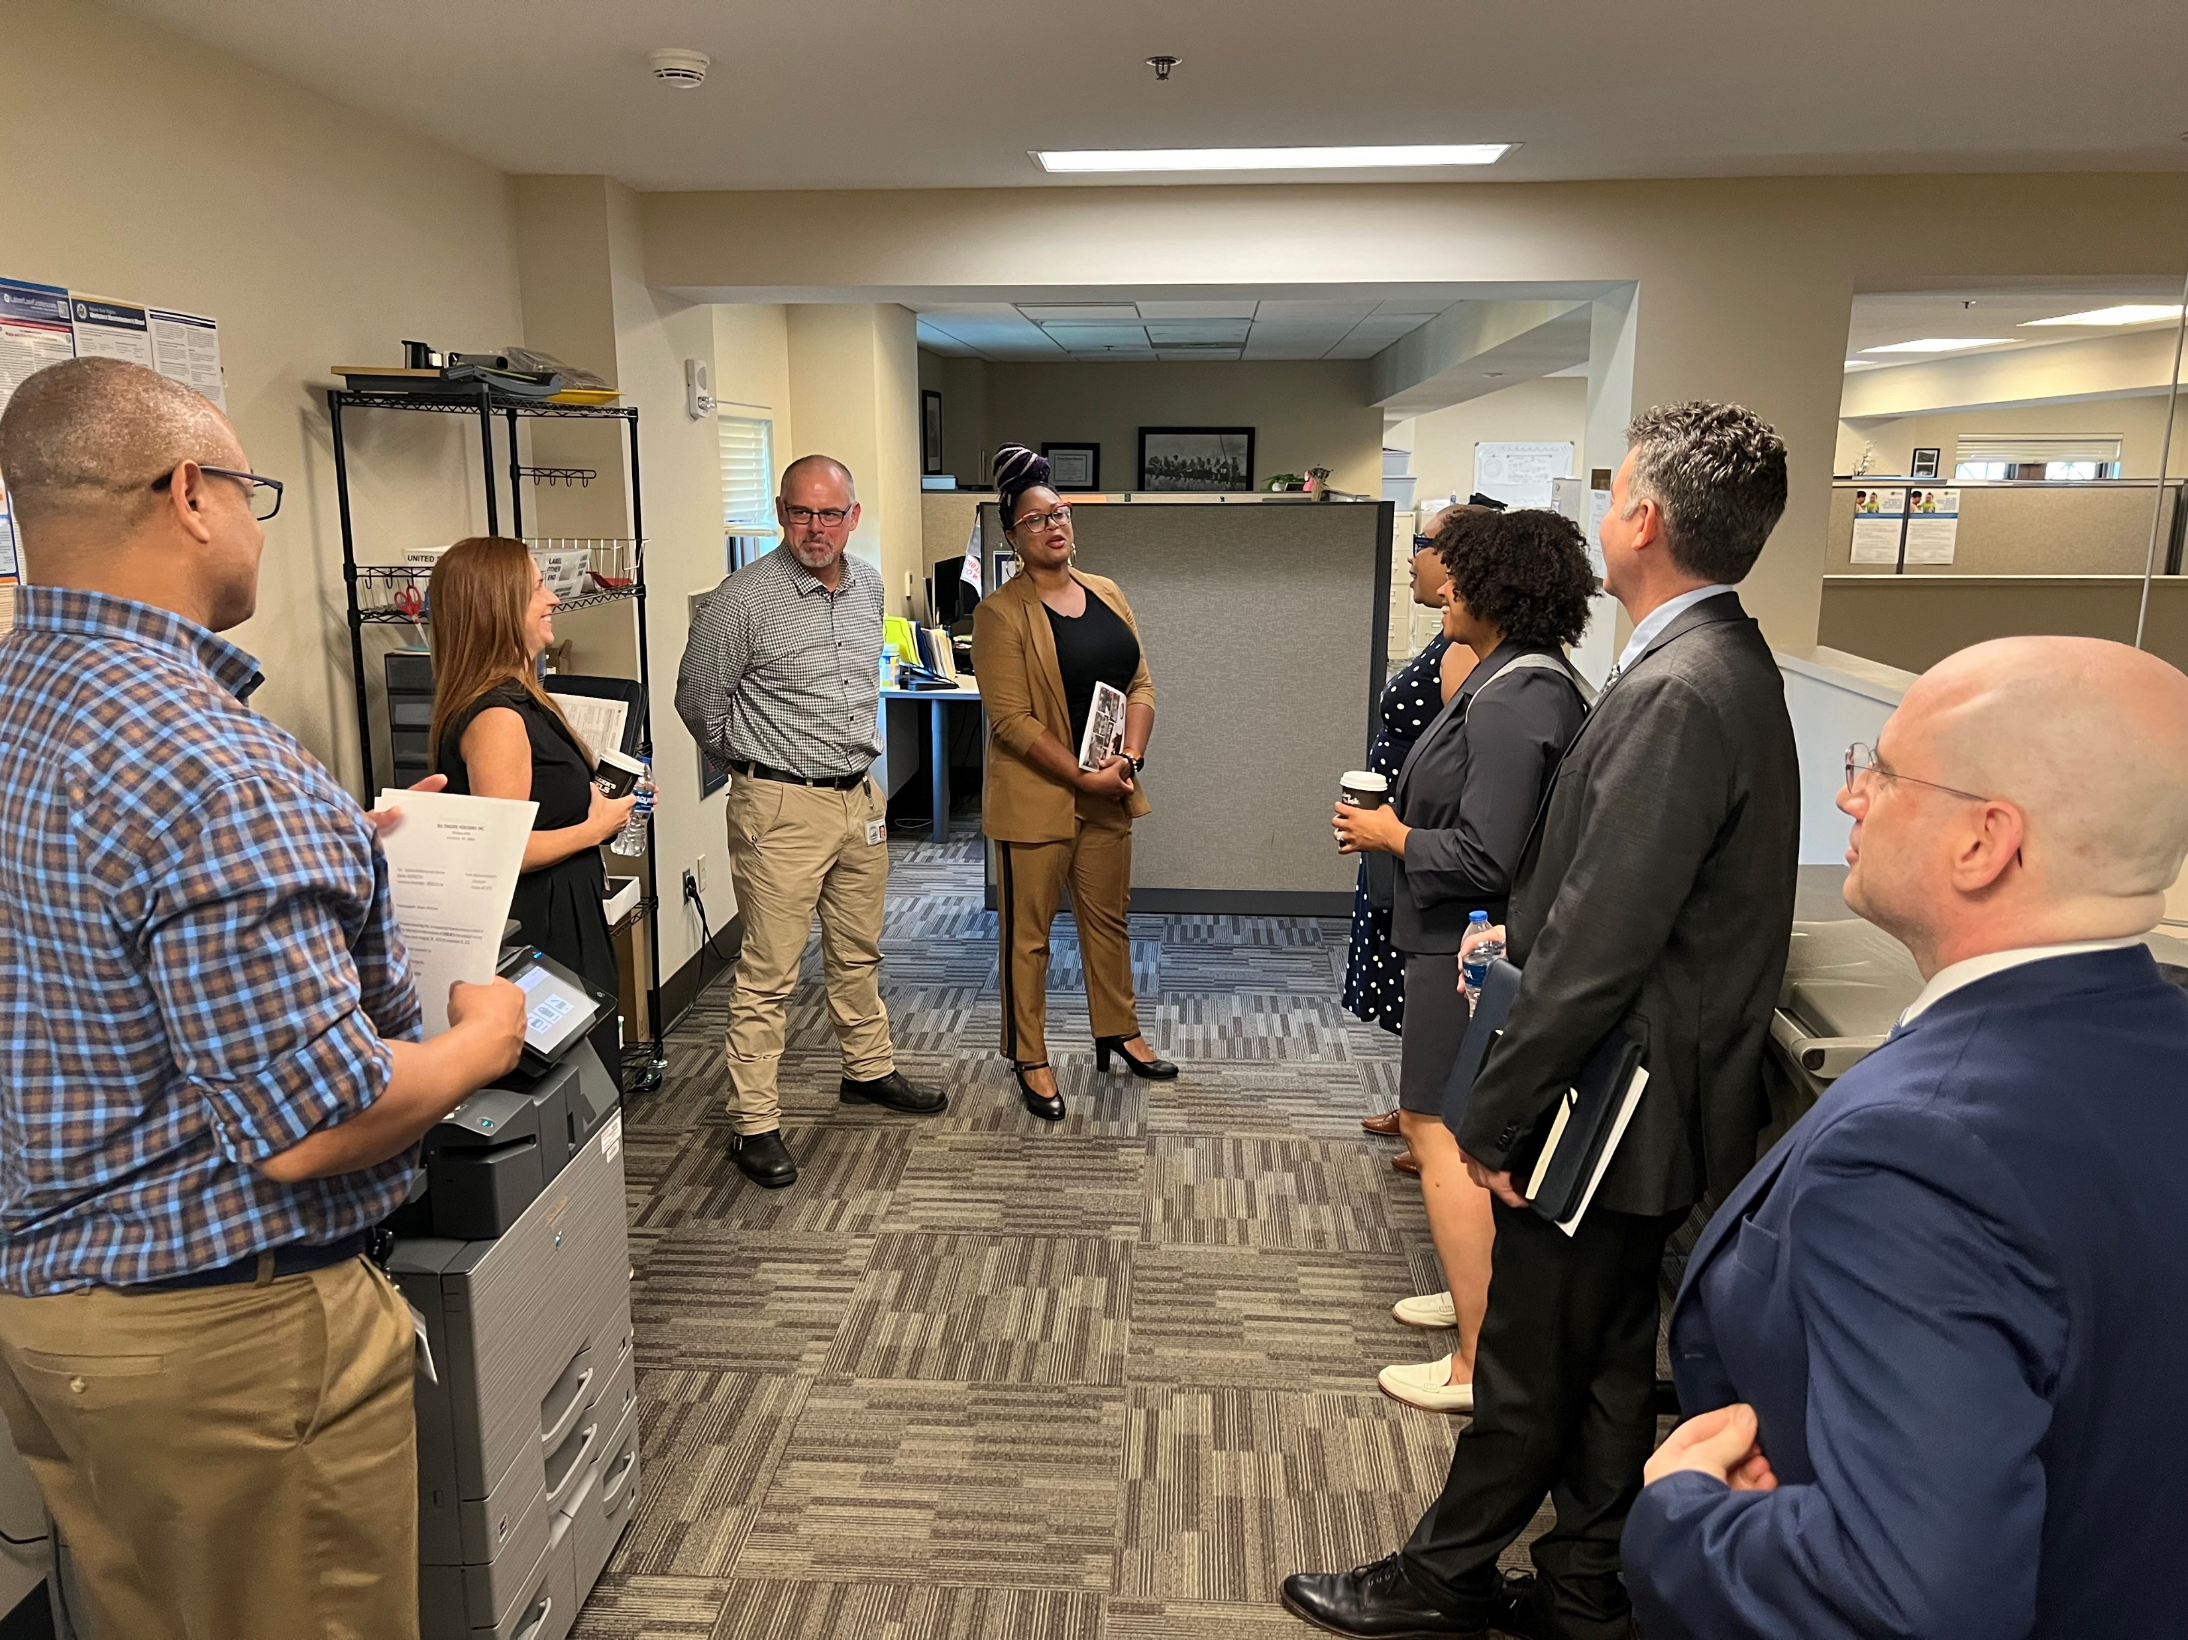
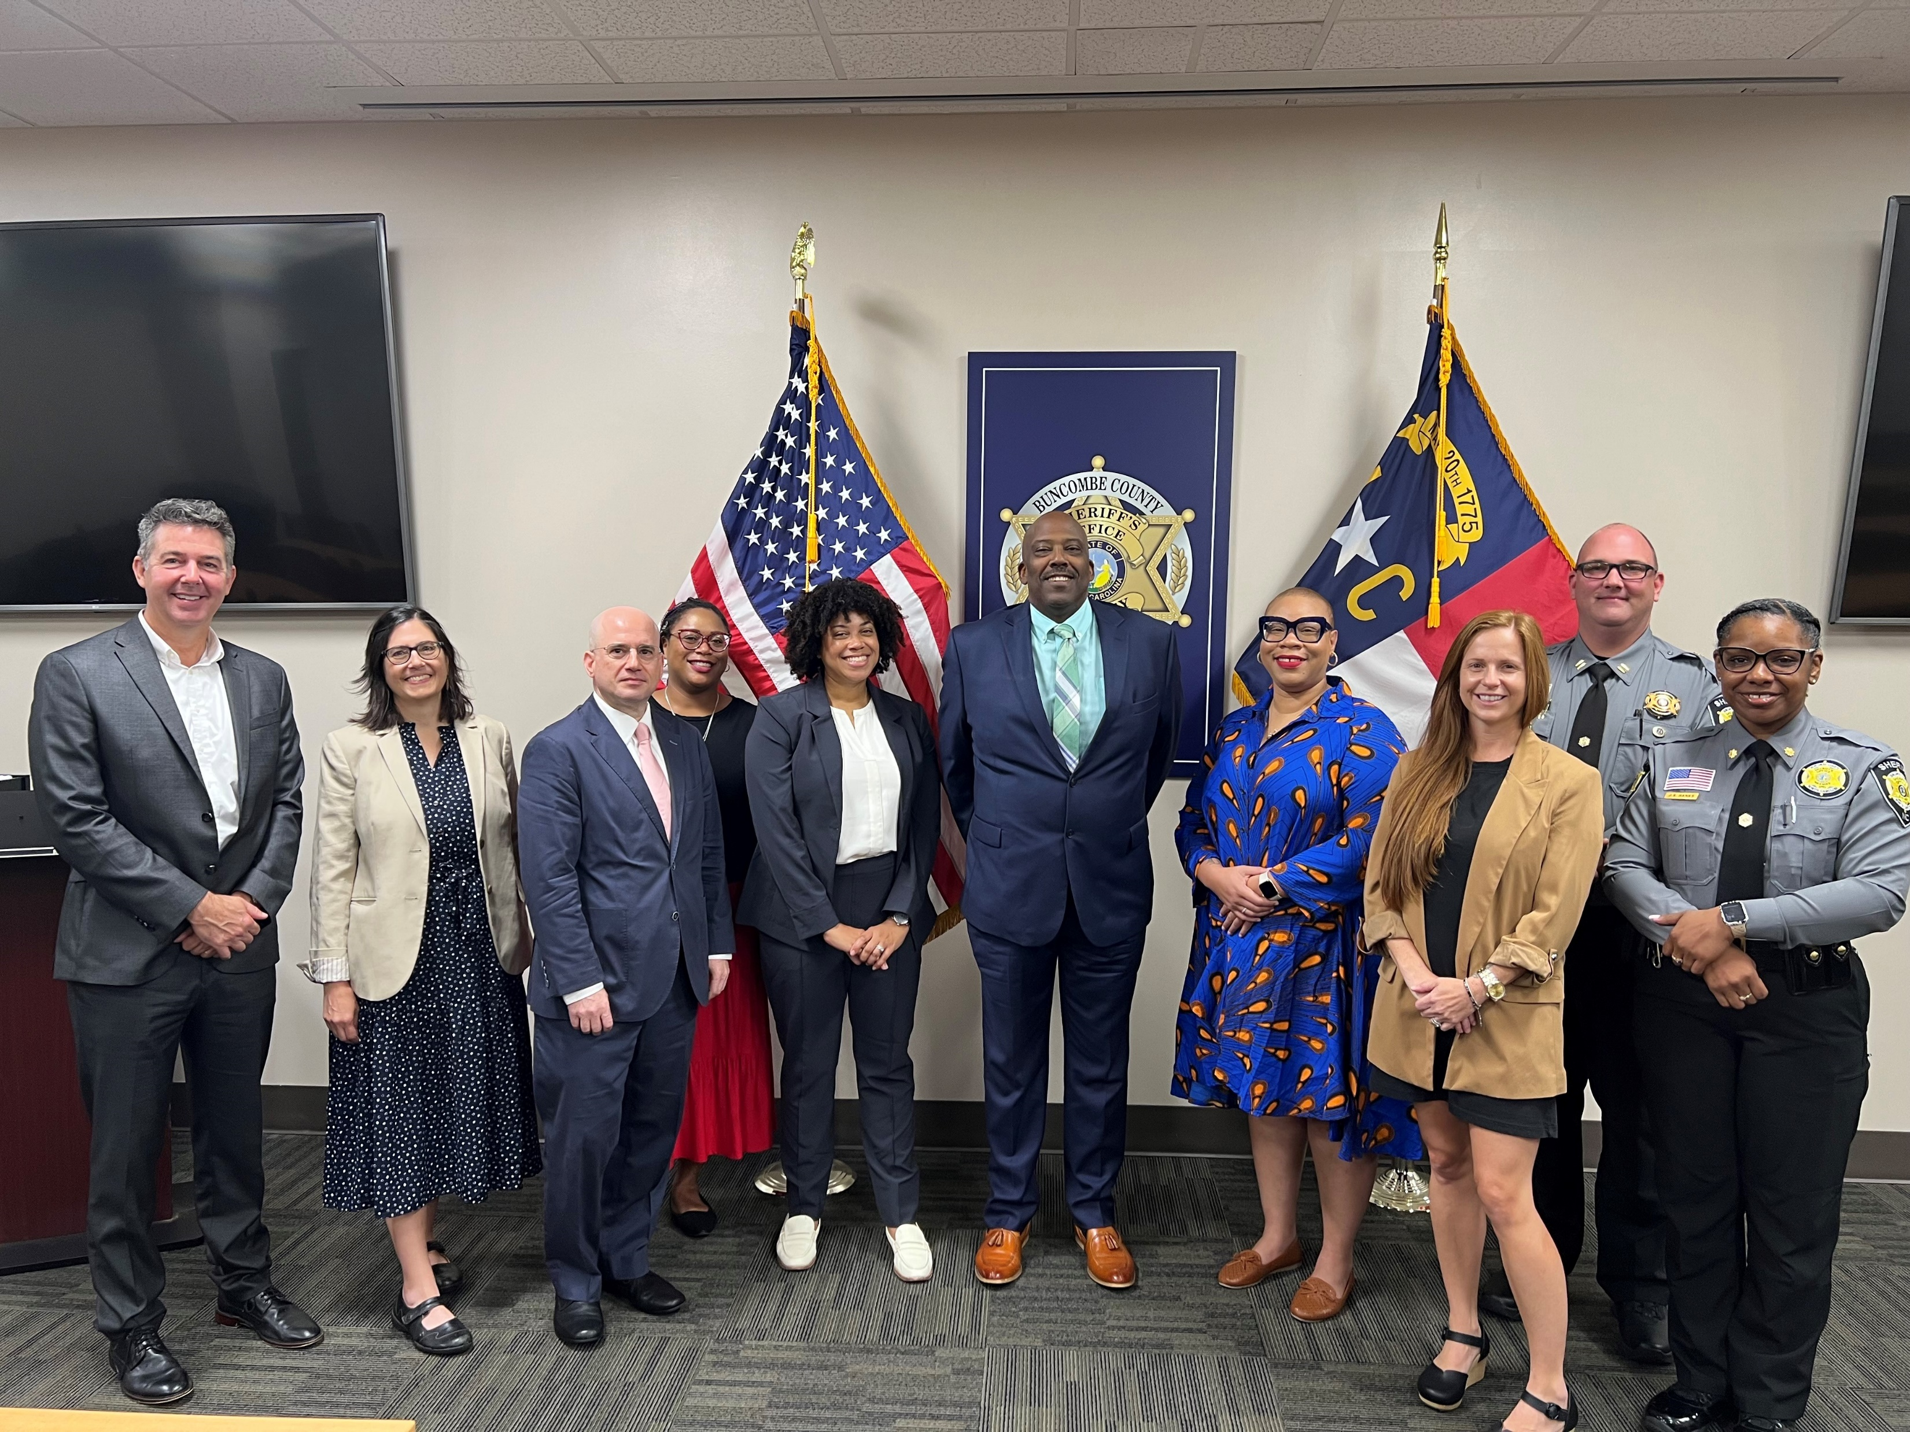
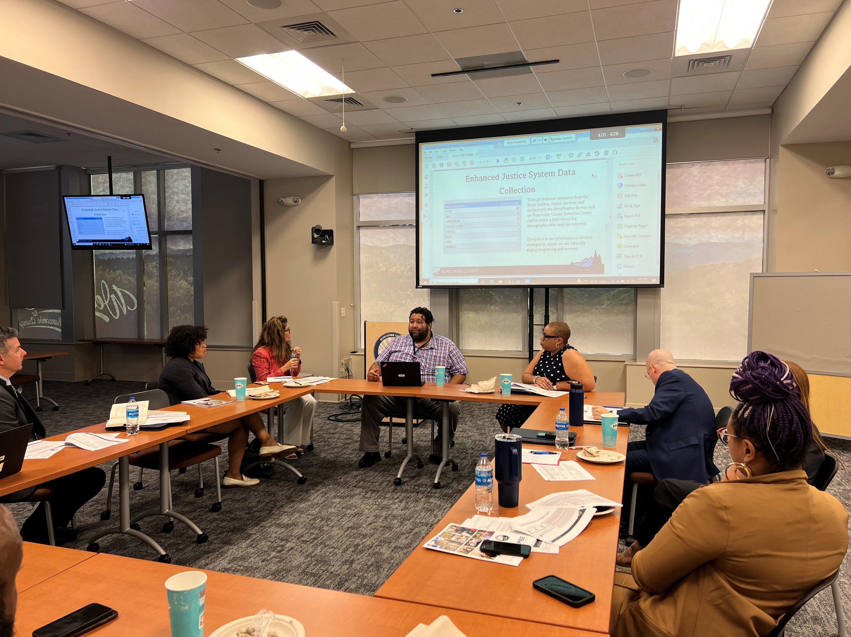
Site Visit from The MacArthur Foundation, JMI Justice, and VERA Institute 8/31/23 – 9/1/23

Slide 25
THANK YOU!

