Slide 1
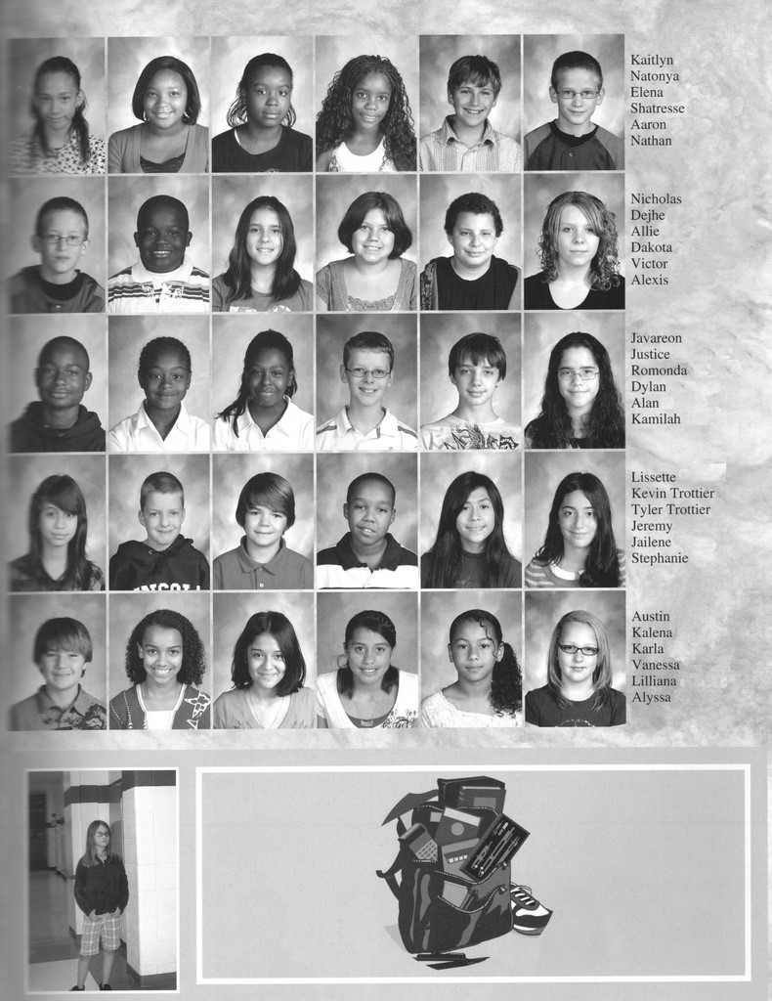
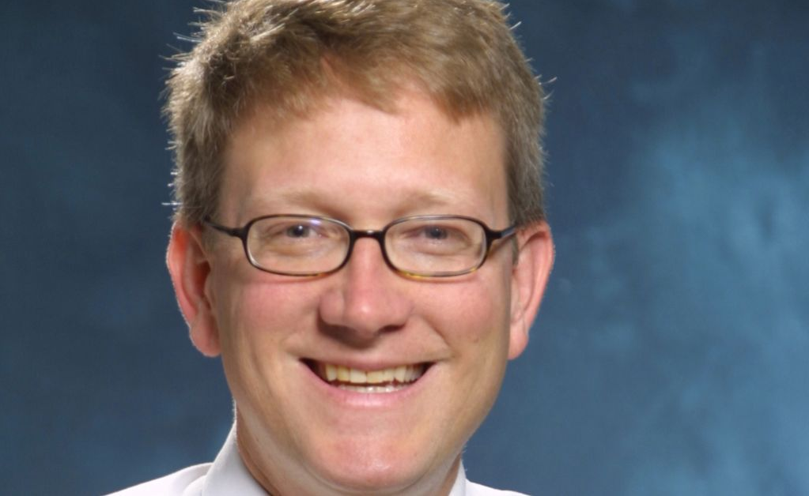
Dr. Blake Fagan
Stopping the Epidemic of Prescription Painkiller and Opioid Addiction and Death
Chief Education Officer, Mountain Area Health Education Center
Assistant Residency Director MAHEC Family Medicine Residency Program
Assistant Medical Director, MAHEC Division of Family Medicine
Associate Professor, UNC-Chapel Hill SOM

Slide 2
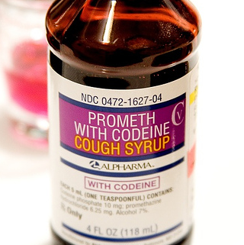
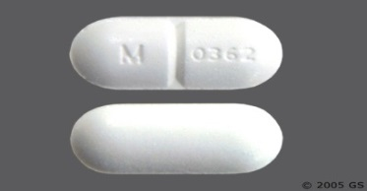
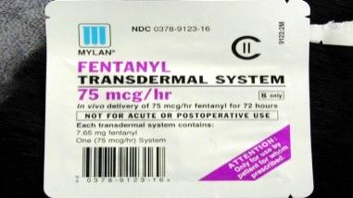
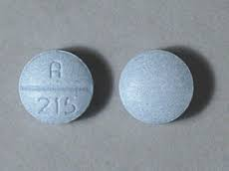
What are opioids (prescription painkillers)?
Codeine
Oxycodone
Vicodin
Fentanyl
Notes:
Opioids are chemicals that are either produced from the opium poppy plant or created in a lab to have the same effects. Some opioids are prescription medicines, such as oxycontin or vicodin.
Some are medicines that are produced illicitly. Some are illegal drugs.
Opioid drugs work by binding to opioid receptors in the brain, spinal cord, and other areas of the body. They reduce the sending of pain messages to the brain and reduce feelings of pain.

Slide 3
The United States has 4.6% of the world’s population, yet we use 80% of the world’s opioids.1
Notes:
The pill to person ratio is almost double in WNC. 7.8 percent of NC's population lived in WNC in 2015 and obtained 13.3 percent of the opioids prescribed statewide.
1. Seya M-J, Gelders SF a M, Achara OU, Milani B, Scholten WK. A first comparison between the consumption of and the need for opioid analgesics at country, regional, and global levels. J Pain Palliat Care Pharmacother. 2011;25(1):6-18. doi:10.3109/15360288.2010.536307.

Slide 4
OVER 17 MILLION PAINKILLERS PRESCRIBED IN BUNCOMBE COUNTY IN 2016. 2
This equals almost 68 pills for every Buncombe County resident
Notes:
This equals almost 68 pills per every Buncombe County resident
Swimming in a toxic sea of pills and it has consequences….heroin use, Ods, suicide, babies born, families separated.
2. https://www.ncdhhs.gov/divisions/mhddsas/ncdcu/prescription-rates-by-county

Slide 5
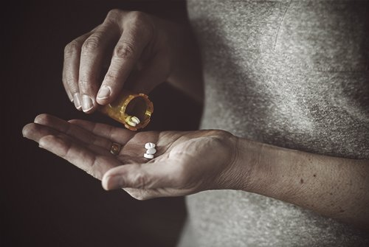
What we know now … It only takes a little to become addicted
Notes:
Opioids are useful in end of life situations- not necessarily cancer but can be used for severe trauma for a short period of time.

Slide 6
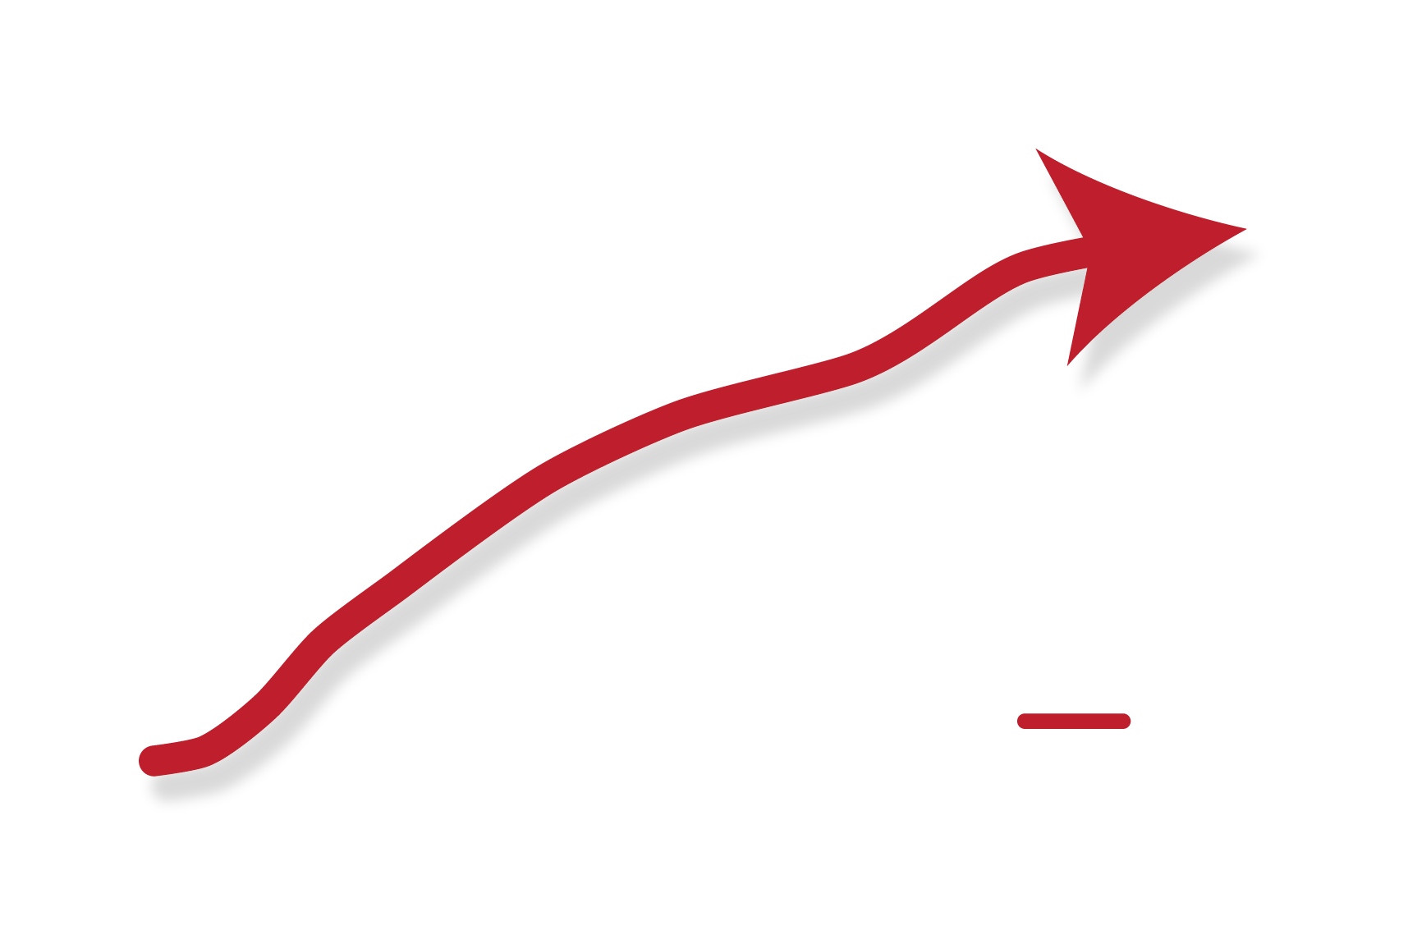
Your risk of addiction rises quickly with each day you take painkillers. 3
Notes:
Opioid medications can produce a sense of well-being and pleasure because these drugs affect brain regions involved in reward. People who abuse opioids may seek to intensify their experience by taking the drug in ways other than those prescribed.
For some, it can take as little as a week to become dependent on painkillers. Once addicted, the patient continually seeks to prevent the withdrawal symptoms, others seek the euphoria they felt in the beginning – before they developed a tolerance – but they are never able to achieve it again. Some overdose and die trying. Others are self medicating by constantly taking the opioid only to prevent the withdrawal symptoms.
3. One- and 3-year probabilities of continued opioid use among opioid-naïve patients, by number of days’ supply* of the first opioid prescription — United States, 2006–2015
https://www.cdc.gov/mmwr/volumes/66/wr/mm6610a1.htm

Slide 7
…
We all have a role to play in this public health crisis.
Notes:
Understanding that the negative public perception of addiction can keep people and their families from getting the help that they need.
Providers and patients understanding that pain relief doesn’t always have be through prescription painkillers.
Not ever giving prescription painkillers to anyone other than who they were prescribed to.
Locking meds and disposing of them properly.

Slide 8

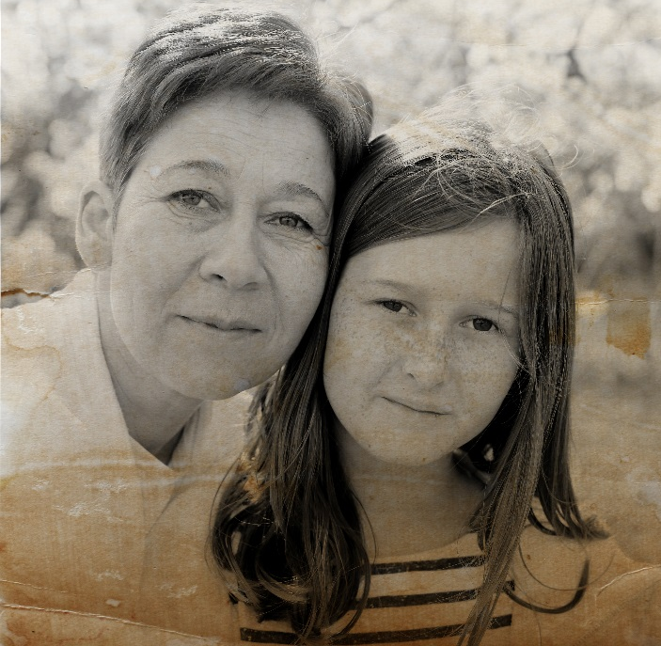
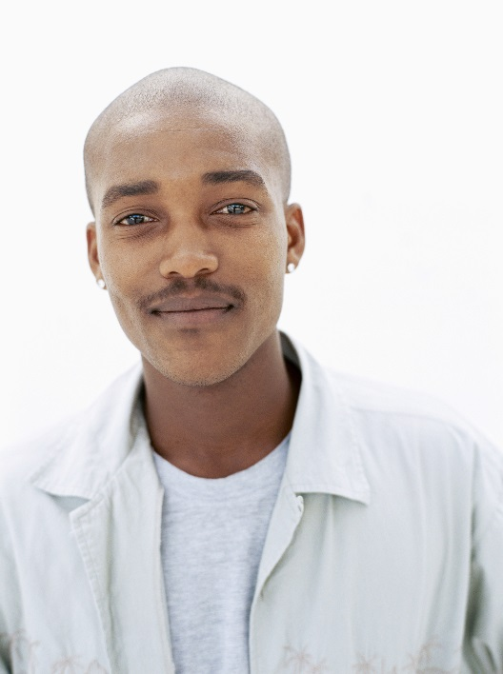
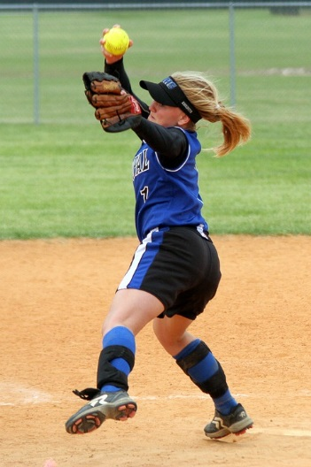
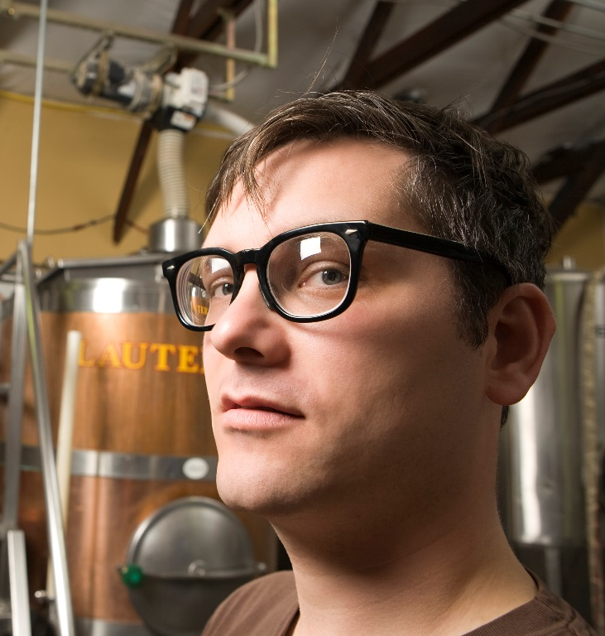
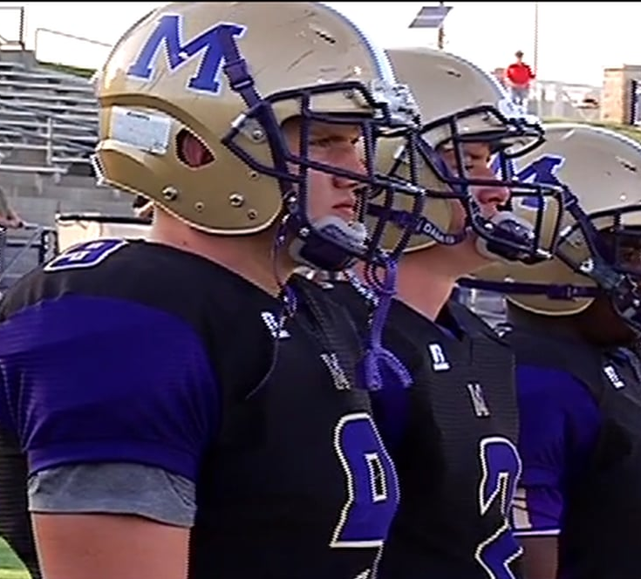
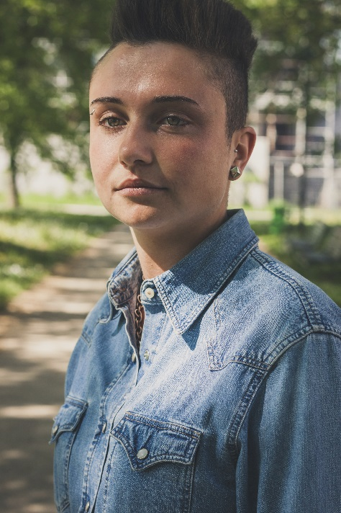
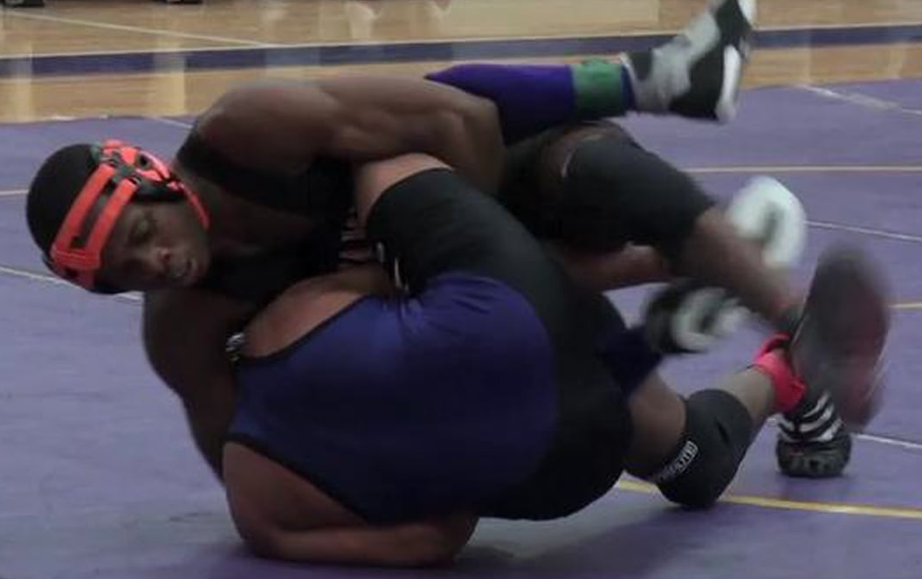
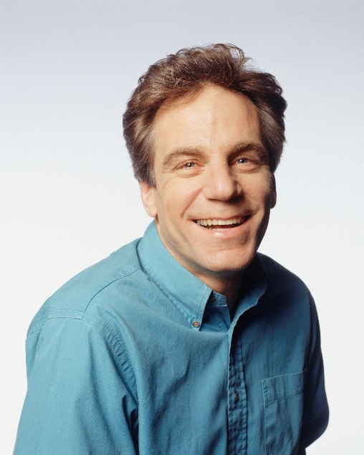

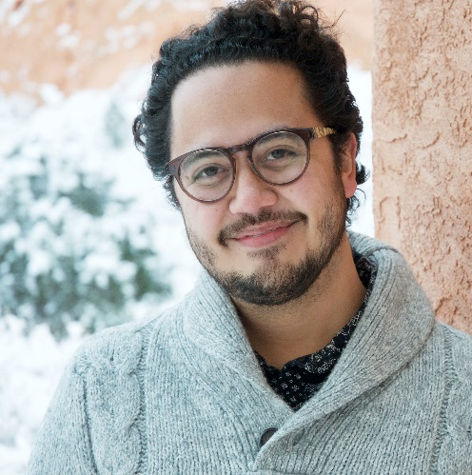
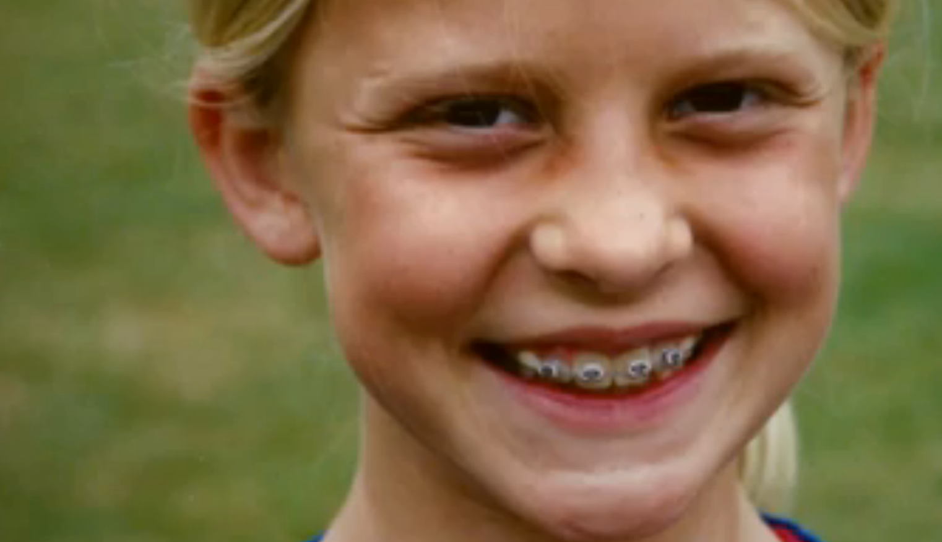
Notes:
What we see is that addiction can happen to anyone and we must separate a person from their addiction. Addiction has probably touched everyone in this room.
There isn’t anything inherently wrong with someone who is addicted to drugs or their family. They don’t need to hide but they do need to seek out help for themselves as much as the child. Often times the negative public perception of addiction can create a situation where a person or family doesn’t want to acknowledge that there is an issue or try to reach out for help.
Why do people start abusing opioids?
A person may:
Begin to misuse meds by increasing the dose on their own
Use to cope with emotional stress or pain or trauma
Experiment with opioids as a way to get high

Slide 9
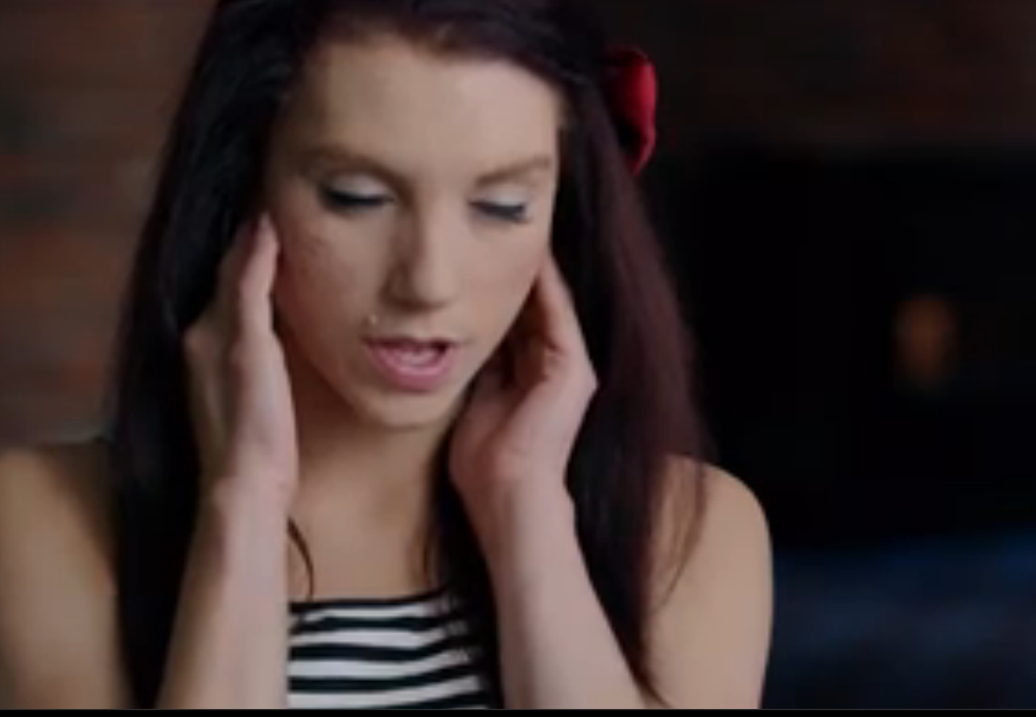
“Heroin literally has a brain and it shares mine.”
-Kristina Block
Notes:
Fear of withdrawal is one reason that they continue to use. Withdrawal undoes everything that opioid intoxication does – and when the pendulum swings back it can be very painful.
Opioids bind to the receptors in the brain that control pain perception. Initially, it gives the user an enhanced sense of warmth and confidence. No stress! But as the use continues, the user has to use more and more to achieve a fraction of what that initial sensation was like. And this can lead to use of other opioids, such as heroin- which is cheaper and sometimes more available.
If a user gets through physical withdrawal they may then experience emotional withdrawal: missing the feeling of being high. This can result in relapse, which means that a user starts using again.
Relapse is dangerous because a user may go back to using the same dosage they did prior to stop using, but their body is not ready for it. What do you think happens at this point?

Slide 10
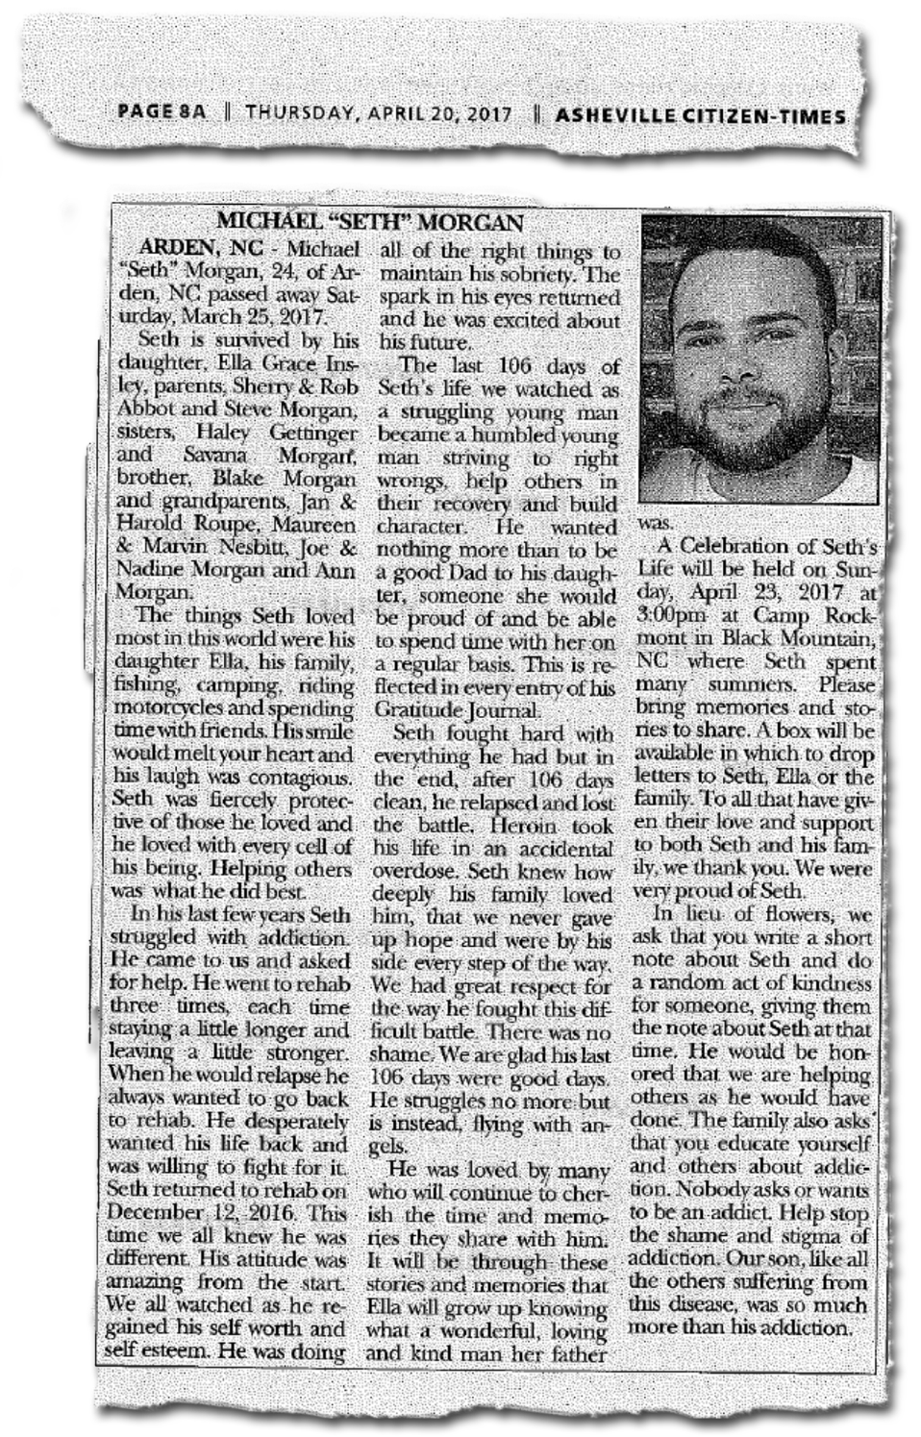
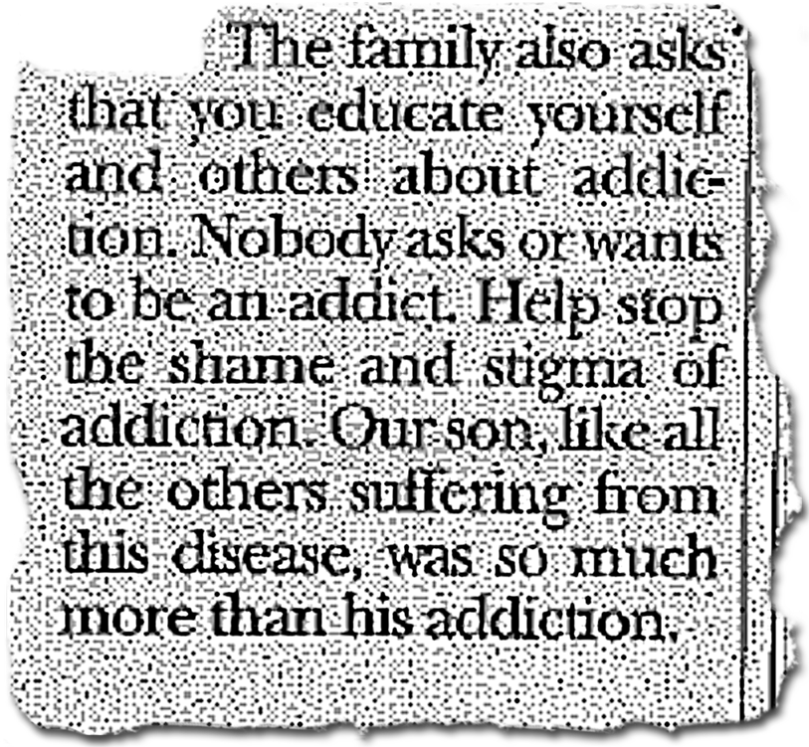
The disease of addiction thrives in darkness and must be defeated in the light
Notes:
And we treat addiction differently, don’t we? Than other chronic diseases. If you have been diagnosed with diabetes, we don’t stop treating you with insulin if you don’t follow your diet and exercise routine, right? We don’t stop giving you insulin because your body isn’t making enough.
It’s important to separate the person from the addiction if we are to make it easier for someone to get help.
Science has proven that substance use disorder is a chronic brain disease that can be managed with medical treatment. It is NOT a moral failing or a character flaw. We must reduce the negative public perception of addiction to remove barriers to getting help. Because right now, only 1 in 10 Americans with a substance use disorder receive treatment.¹
Addiction is highly stigmatized, and that stigma is fueling an American public health crisis. With both cancer and HIV: when stigma was reduced, lives were saved. And the same can be true of addiction.

Slide 11
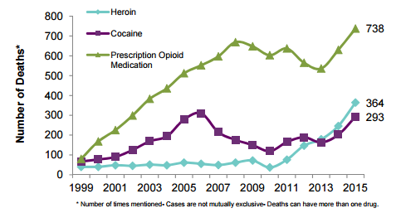
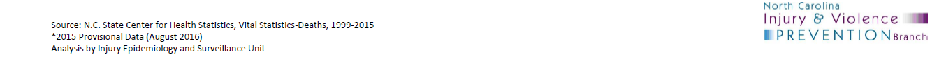
*Number of times mentioned- cases are not mutually exclusive- deaths can have more than one drug.
Notes:
If current trends continue, unintentional poisoning deaths will surpass motor vehicle deaths as the leading cause of injury death in North Carolina by 2017.
This data is the tip of the iceberg… we know that addiction is everywhere in our community, across homes and neighborhoods
http://www.injuryfreenc.ncdhhs.gov/About/PrescriptionFactSheet2015-Oct2016.pdf

Slide 12
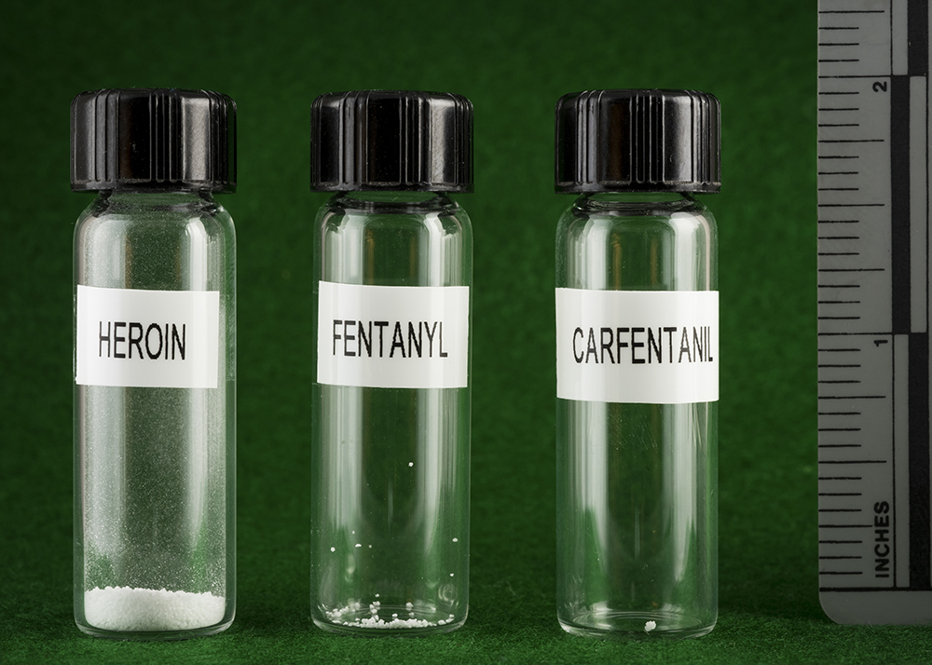
It doesn’t take a lot to kill
NEW HAMPSHIRE STATE POLICE FORENSIC LAB
Notes:
While prescription opioid related deaths are on the rise, it’s important to note that when someone turns to street drugs, there are some pretty scary things out there. Fentanyl is a stealth killer, often sold to clueless buyers as heroin, prescription pain pills or the anti-anxiety medication Xanax. It’s deadly because it’s so much stronger than heroin, as shown by the photograph above, which was taken at the New Hampshire State Police Forensic Laboratory. On the left is a lethal dose of heroin, equivalent to about 30 milligrams; on the right is a 3-milligram dose of fentanyl, enough to kill an average-sized adult male.
Drugs users generally don’t know when their heroin is laced with fentanyl, so when they inject their usual quantity of heroin, they can inadvertently take a deadly dose of the substance.
The drug has flooded the marketplace as street dealers on up to major international cartels have discovered that it delivers heroin’s high at a fraction of the cost. This creates a paradox where the profit margin for drug sellers skyrockets as the street price for opioids drops.
The result: Fentanyl is poised to become the catastrophic exclamation point to 20 years of escalating opioid addiction in the United States.

Slide 13
The epidemic is everywhere in our community
Notes:
It is in our doctor’s offices, our schools, our workplace, in our homes, and in our families. And it is threatening to tear our community apart.

Slide 14
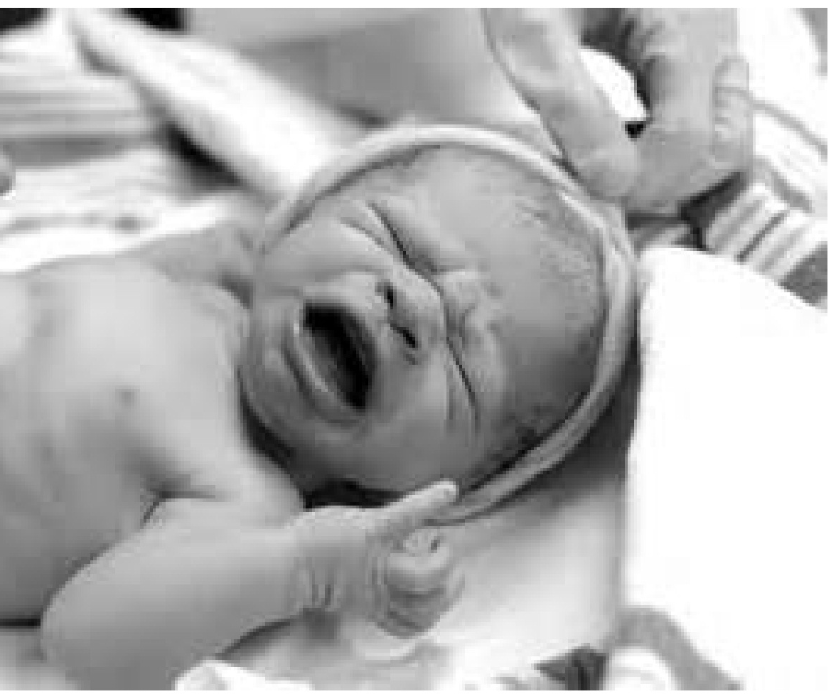
399
Babies born at Mission tested positive for substances.
The majority of children in foster care have a parent that struggles with a substance use addiction.
Notes:
(154 of these are Buncombe County babies)
NC: From 2004-2013, there has been a 604% increase in hospitalizations associated with drug withdrawals in NEWBORN BABIES.

Slide 15
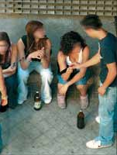
Buncombe County EMS responded to 1,270 overdose calls between Jan 2017- May 2017.
194 OD calls by the middle of May alone
Notes:
Buncombe County EMS Data

Slide 16
…
Does any of this information surprise you?

Slide 17
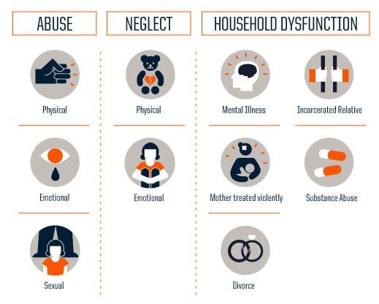
Risk for addiction can be increased by traumatic experiences.
Notes:
At risk:
Symptoms of trauma - Stress, depression
Access to an addictive substance is another risk factor.
4. Khoury, Lamya et al. “Substance Use, Childhood Traumatic Experience, and Posttraumatic Stress Disorder in an Urban Civilian Population.” Depression and Anxiety 27.12 (2010): 1077–1086. PMC. Web. 26 July 2017.

Slide 18
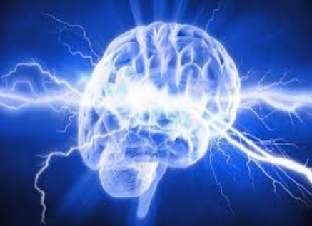
The ESSENCE of what drives teenage behavior
Emotional Stimulation/Spark
Social Engagement
Thrill seeking behavior
Opening windows to creativity through drugs
Notes:
More than 90% of adults with substance use disorders started using before age 18
half of these cases started using drugs before age 15
In short, being a teenager is a risk factor
**SAMSHA report

Slide 19
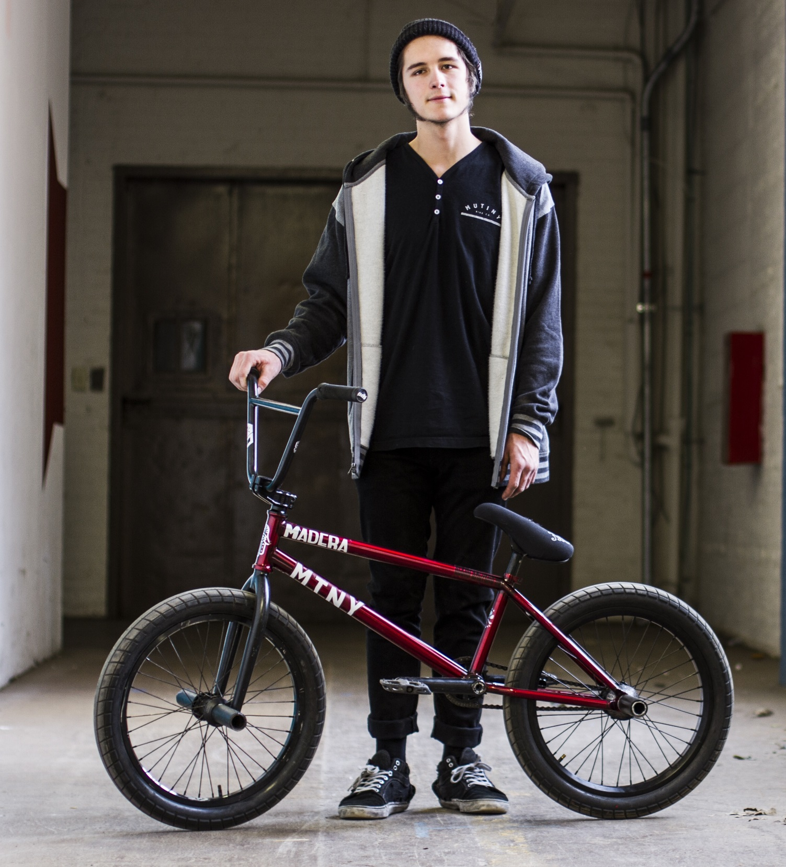
Encourage caregivers to talk to their children.
Children who learn about the dangers of drugs at home are up to 50 percent less likely to use drugs.*
Notes:
One of the biggest reasons kids give for not using is that they don’t want to disappoint their parents but most teens say that their parents have not talked with them about prescription drug abuse
*5. Substance Abuse and Mental Health Services Administration, Results from the 2013 National Survey on Drug Use and Health: Summary of National Findings, NSDUH Series H-48, HHS Publication No. (SMA) 14-4863. Rockville, MD: Substance Abuse and Mental Health Services Administration, 2014.

Slide 20
Signs of Substance Misuse / Addiction:
Pinpoint pupils
Unkempt, dirty appearance
Track marks
Laughs at nothing
Cash flow issues / missing valuables
Missing / burnt spoons
Withdrawn or depressed
Makes endless excuses
Uncharacteristically loud, obnoxious behavior
Notes:
Some of the most dramatic signs are these that are listed on the slide.
Other signs are a dirty, unkempt appearance and general neglect of hygiene, which are strong indicators of drug use.
they may appear depressed, and/or withdraw socially And you may see track marks – which commonly occur on hands and arms (which is why they may wear long sleeved shirts even when it’s inappropriate for the weather). However, someone who has used for a while will inject anywhere they can find a vein.
You may find missing or burnt spoons, which are used to smoke heroin, or foil or missing money or valuables – heroin and pills aren’t free.
The best advice is to trust your instincts. If something doesn’t seem right, it might not be.
https://www.youtube.com/watch?v=16YhXNlC414

Slide 21


Prescription painkillers are a last resort.
Ask doctors and nurses:
What are the risks associated with painkillers?
Are there other ways to treat the pain other than painkillers?
What are the side effects of painkillers?
When can I switch to acetaminophen (Tylenol) and ibuprofen (Advil)?
Remind Parents: Never ever share your meds
Notes:
Advocacy

Slide 22
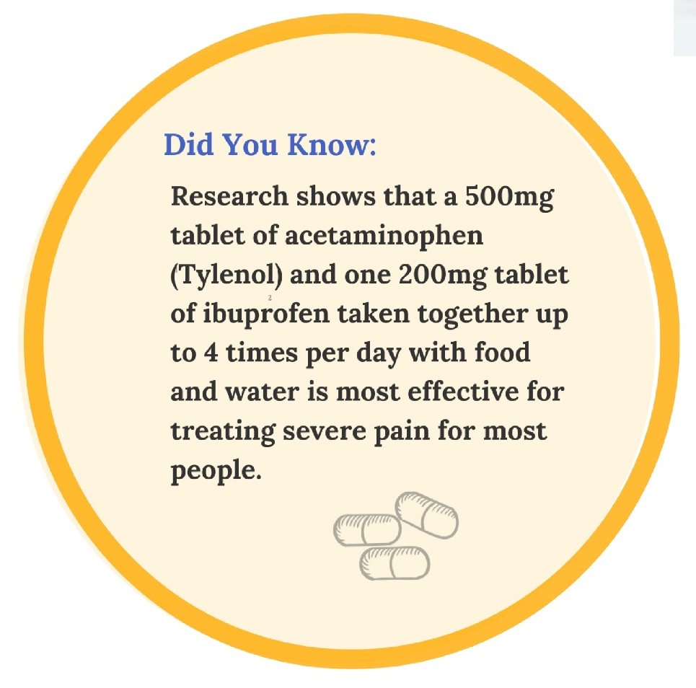
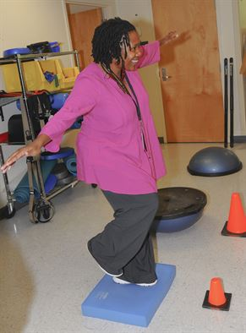

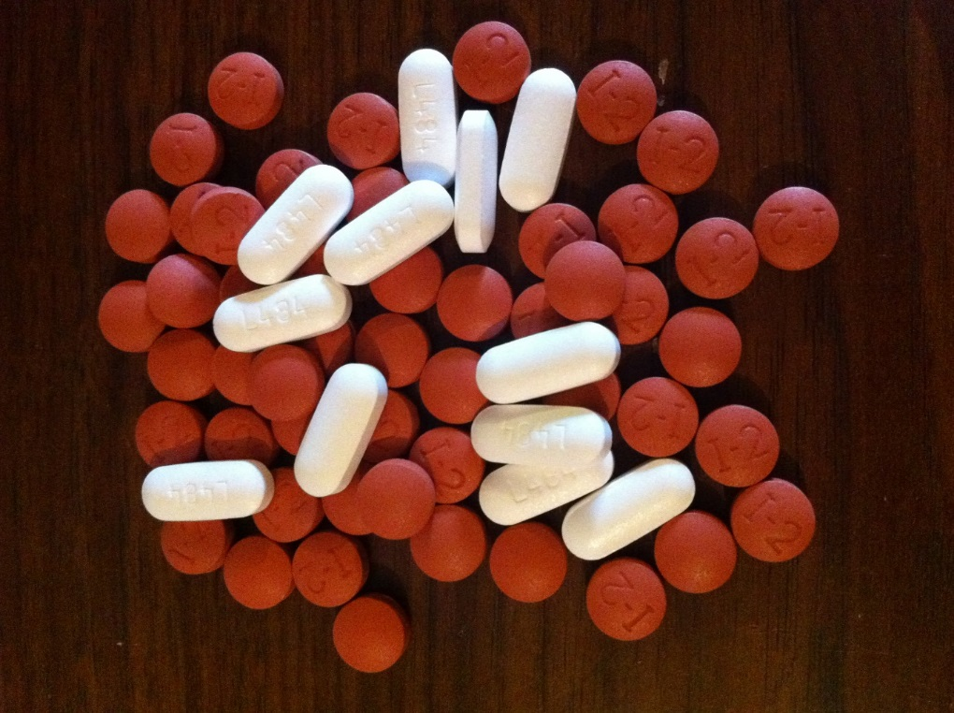
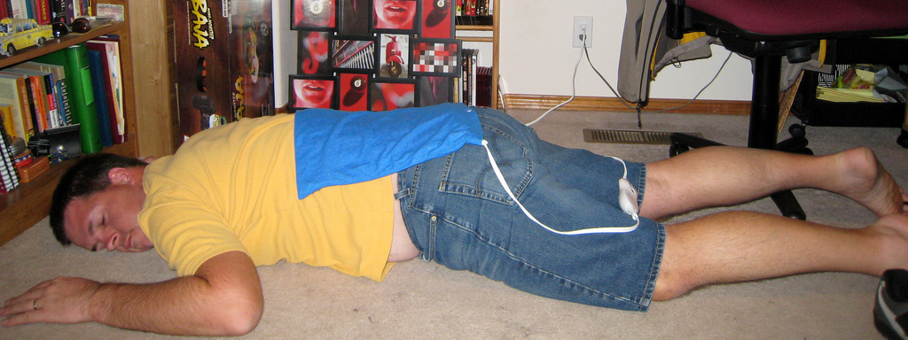

Slide 23
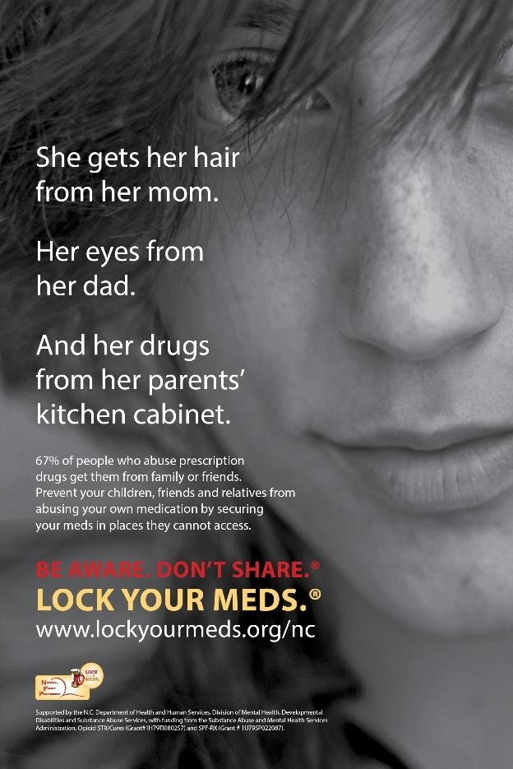
Simple steps to help:
Count the number of painkillers in your home
Secure your pills
Drop off unused pills at a RX Drop-Off Location
Ask your friends & family to do the same
Notes:
We are all at risk, especially our children. Most abused prescription drugs come from family and friends. You could be a drug dealer without even knowing it.
Everyone in Buncombe County should take the following steps:
Count the number of painkillers in your home
Secure your pills
Drop off unused pills at a RX Drop-Off Location
Ask your friends & family to do the same

Slide 24
Safely Dispose of Your Prescription Drugs
The lobby of the Buncombe County Sheriff’s Office at 339 New Leicester Hwy
The Buncombe County Courthouse at 60 Court Plaza
Lobby of the Asheville Police Department at 100 Court Plaza
Walgreens Pharmacy 1835 Hendersonville Rd. Asheville, NC 28803
Notes:
There are three prescription drug drop boxes in Buncombe County. They are located:
the lobby of the Buncombe County Sheriff’s Office at 339 New Leicester Hwy,
the lobby of the County Courthouse at 60 Court Plaza,
the lobby of the Asheville Police Department at 100 Court Plaza.
When dropping off medications, please follow these instructions:
remove identification from all medications.
separate pill, liquids and inhalers.
use a different disposal paper or plastic bag for each type of medication.
empty dry pill medications into a bag
leave liquid medications in their original container and place in a separate bag
NO radioactive medications such as cancer medications, needles or sharpes accepted.

Slide 25
Get help for yourself or loved ones.
Call VAYA Health at 1-800-849-6127
Notes:
(Toll free 24/7)

Slide 26
Protect yourself and others:
Syringe Exchange and Disposal: The Steady Collective can be contacted at steady@thesteadycollective.org
Free HIV and Hep C Testing: WNCAP can be reached at (828) 252-7489 or by email at wncap@wncap.org
STD Testing & Family Planning -Buncombe County Health Department: (828) 250-5000

Slide 27
3 ways each of us can help:
Talk about this as a health epidemic to your children and friends.
Know the signs and symptoms of addiction and support those who want to begin their recovery.
Decrease the number of painkillers in use in our community. Ask your doctor for other ways to deal with pain. Secure your painkillers. Safely dispose of unused painkillers.

Slide 28
…
What will you do to stop this epidemic?
Notes:
What scares you the most?
What gives you hope?
What will you do to stop this epidemic?

Slide 29
Want to help spread this information? You can.
Please contact hhspio@buncombecounty.org to schedule a presentation in your community.

Slide 30
Sources
Seya M-J, Gelders SF a M, Achara OU, Milani B, Scholten WK. A first comparison between the consumption of and the need for opioid analgesics at country, regional, and global levels. J Pain Palliat Care Pharmacother. 2011;25(1):6-18. doi:10.3109/15360288.2010.536307.
https://www.ncdhhs.gov/divisions/mhddsas/ncdcu/prescription-rates-by-county
One- and 3-year probabilities of continued opioid use among opioid-naïve patients, by number of days’ supply* of the first opioid prescription —https://www.cdc.gov/mmwr/volumes/66/wr/mm6610a1.htm
Khoury, Lamya et al. “Substance Use, Childhood Traumatic Experience, and Posttraumatic Stress Disorder in an Urban Civilian Population.” Depression and Anxiety 27.12 (2010): 1077–1086. PMC. Web. 26 July 2017.
Substance Abuse and Mental Health Services Administration, Results from the 2013 National Survey on Drug Use and Health: Summary of National Findings

Slide 31
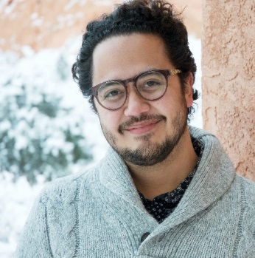







Buncombe County Speakers’ Bureau:
Prescription Painkiller Addiction
This train-the-trainer opportunity is designed to support speakers throughout the community as they have the conversation about painkiller addiction.
Topics include:
An overview of the epidemic of painkiller addiction
Practical ways to prevent addiction from taking root
Steps to safety and support for substance use disorder
Core messages about this public health epidemic
Join us for a train-the-trainer on these dates:
September 5 (8am-10am) - Register
September 26 (2-4pm) - Register
October 5 (5:30-7:00pm) - Register
October 10 (2-4pm) - Register
October 17 (8:30-11am) - Register
Contact Info: Chiloh.Campbell@buncombecounty.org

Slide 32
Combatting the Epidemic:
How to fight this epidemic:
Talk to your children: Children who learn about the risks of drugs at home are 50 percent less likely to use drugs.
Find other ways to relieve pain: Research shows that a 500 mg tablet of acetaminophen and one 200 mg tablet of ibuprofen taken together up to 4 times per day with food and water is most effective for treating severe pain for most people.
Count and secure any painkillers in your home.
Drop off unused pills at a RX Drop-Off Locations:
Buncombe County Sherriff's Office- Downtown Asheville- County Courthouse
The lobby of the Buncombe County Sheriff’s Office at 339 New Leicester Highway
Asheville Police Department
Walgreens Pharmacy 1835 Hendersonville Rd. Asheville, NC 28803
Ask your friends and family members to discard unused medications
Know the signs and symptoms of addiction and understand that addiction is not a moral failing.
The epidemic of prescription painkiller addiction is everywhere in Buncombe County. We all have a role in stopping it.
It only takes a little to lose a lot:
Prescription painkillers are highly addictive and can lead to use of street drugs like heroin.
Opioids, or painkillers include:
Oxycodone
Codeine
Fentanyl
Signs of Addiction:
Withdrawn or depressed
Makes endless excuses / cash flow issues
Is uncharacteristically loud or obnoxious
Need help with substance use:
Vaya Health- Call 1-800-849-6127 for 24/7 help with services and support for mental health and substance abuse.
Call 911 if there is a medical emergency.
Vicodin
Heroin
Narcan can save the life of a person experiencing an overdose. If someone you love uses opioids get a kit and get trained to use it while you get them into treatment. Visit www.thesteadycollective.org for information on harm reduction in Buncombe County.
Over 17 million painkillers were prescribed in 2016 in Buncombe County. That equals 65 pills per person.
399 babies were delivered at Mission with substances in their system.
Drug overdose deaths have become the leading cause of death in the United States.
Syringe Exchange:
The Steady Collective can be contacted at steady@thesteadycollective.org
Free HIV and Hep C Testing: WNCAP can be reached at (828) 252-7489 or by email at wncap@wncap.org
STD Testing & Family Planning -Buncombe County Health Department: (828) 250-5000
Addiction:
Addiction is a chronic, relapsing brain disease characterized by compulsive drug seeking and use, despite harmful consequences. Addiction is not a moral failure. It is considered a brain disease because drugs change the structure of the brain and how it works.

