Slide 1
CHILD CARE WORKFORCE: SETTING THE STAGE IN BUNCOMBE COUNTY JULY 2023

Slide 2
FACTORS : ECE WORKFORCE SHORTAGE
Compensation & benefits
High BC housing costs
Transportation
Lack of child care slots for own children
Higher child & family needs following pandemic
High stress job environment
High expectations (education, standards, licensing rules)

Slide 3
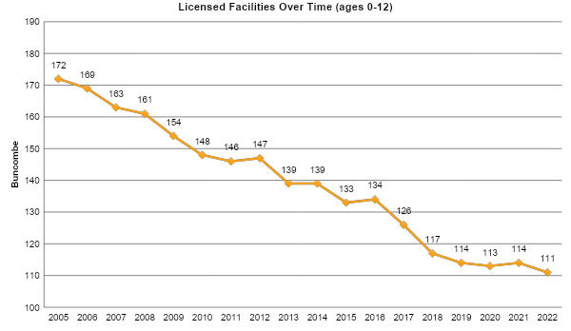
Notes:
Source: NC Division of Child Development and Early Education, Monthly Statistical Reports; September month of each year.

Slide 4
Buncombe Child Care Slots:
Enrollment Changes
2020-2023
 | Feb 2020 | April 2023 | % Change
Children enrolled in licensed child care (0-5) | 4237 | 3598 | 15% loss
Notes:
Source: NC Division of Child Development and Early Education, Monthly Statistical Reports (April 2023, most recent report available)
Summary reports are available approximately 60 days following the last day of the month in question. For example, if you are looking for the June Statistical Summary, it will be available for review by approximately the end of August.
Due to trends and advances in person re-identification and vulnerabilities of rolling data, the Division of Child Development and Early Education is altering the posting cadence of the Child Care Statistical Report on our public-facing website from monthly to quarterly.

Slide 5
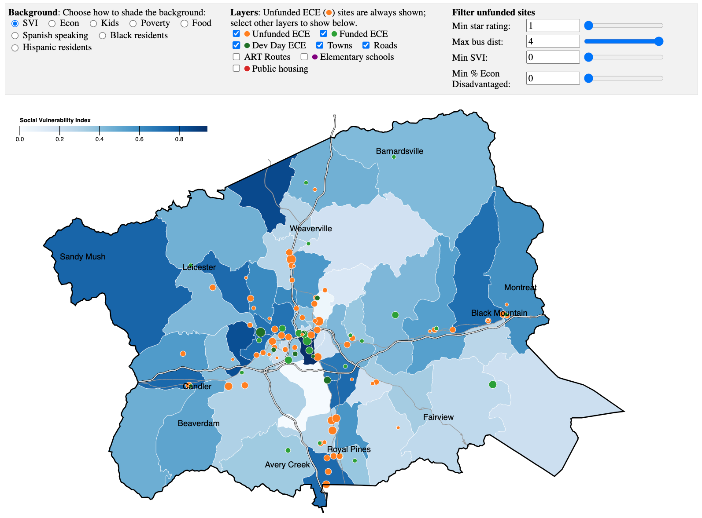
Notes:
The above interactive map was created in June 2023 by WNC Viz with data from Buncombe Partnership for Children, US Census, and various other sources. https://wncviz.com/bpc/
Additional Buncombe GIS ECE maps, created in 2021 by the Buncombe GIS team, can be found here: https://drive.google.com/drive/folders/1CbmNoaF5bRXCOdHWalME3myUEg37cSyc?usp=sharing
Link to story maps created in 2020 by Anja Mayr, MPH, can be found here: https://storymaps.arcgis.com/stories/3ea6ac6d16344076bf4e0fab02a563d9
These interactive maps include data on social vulnerability, early childhood education, and transportation.

Slide 6
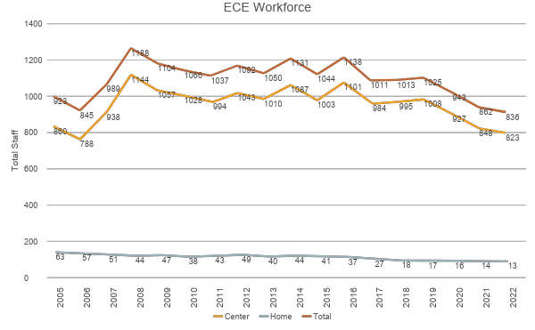
Notes:
Number of teachers, administrators, support staff source: DCDEE Enrollment Report for Centers and Family Child Care Homes, September month selected for all years.
Note: Total number of staff as of Dec. 31, 2022, was 650, a slight increase over September 2022.

Slide 7
THE BUNCOMBE WORKFORCE – BY THE NUMBERS
Number of teachers = 808
Number of administrators = 107
Number of support staff = 77
On average, the early care and education teaching staff made $13.37 per hour and directors made $24.00 per hour.
Notes:
Number of teachers, administrators, support staff, Data Source: Data Source: DHHS Client Services Data Query Tool, DCD Regulatory Reports: Quarterly Enrollment Capacity Education Homes Report Month = June 2023.
Hourly wage information from the report 2019 Early Care and Education Workforce in Buncombe County, Child Care Services Association
https://www.childcareservices.org/wp-content/uploads/CCSA-The-2019-Early-Care-and-Education-Workforce-in-Buncombe.pdf

Slide 8
DCDEE STABILIZATION GRANTS
Total Buncombe jobs impacted = 937
Total child care capacity impacted = 6,923
Buncombe dollars paid to date:
All payments = $17,116,685
Fixed cost payments = $10,335,286
Compensation supports = $6,781,399
Center payments = $16,685,436
Home payments = $431,239
Notes:
NCDHHS Division of Child Development and Early Education has created two data dashboards to provide Child Care Stabilization Grants summary data. The first dashboard gives insight into the impact of this historic investment, showing the total child care capacity and jobs that are supported by the grants both as a statewide to-date total and by county in an interactive map. The second dashboard illustrates the strength of NCDHHS’s commitment to the state’s early care and learning network by showing the total stabilization grant dollars paid to-date to child care programs statewide, and a pie chart of grantees by program type. This dashboard also features an interactive map of stabilization grant payment totals by county with several display options: All Payments, Fixed Cost Payments, Compensation Support Payments, [Child Care] Center Payments, [Family Child Care] Home Payments.

Slide 9
IMPACT: ECE WORKFORCE SHORTAGE
Families: Reduced slots due to staffing
Families: Reduced child care hours available for families
Families: Limited slots for families who use subsidy vouchers, may need to travel further. Fewer providers who can support children with developmental/behavioral needs
Staff: Increased teacher and administrator burnout
Staff: less support available, less time out of the classroom for planning/time off, less attention to proactive mental health supports

Slide 10
QUESTIONS?
Jenny Vial, Director of Child Care Resources
jenny@buncombepfc.org * 828.407.2062
www.buncombepfc.org

